Slide 1
Access Chapter 3
Maintaining a Database

Slide 2
Objectives
Add, change, and delete records
Search for records
Filter records
Update a table design
Format a datasheet
Use action queries to update records

Slide 3
Objectives
Specify validation rules, default values, and formats
Create and use single-valued and multivalued Lookup fields
Specify referential integrity
Use a subdatasheet
Sort records

Slide 4
Plan Ahead
Determine when it is necessary to add, change, or delete records in a database
Determine whether you should filter records
Determine whether additional fields are necessary or whether existing fields should be deleted
Determine whether validation rules, default values, and formats are necessary
Determine whether changes to the format of a datasheet are desirable
Identify related tables in order to implement relationships between the tables

Slide 5
Starting Access
Click the Start button on the Windows Vista taskbar to display the Start menu
Click All Programs at the bottom of the left Pane on the Start menu to display the All Programs list and then click Microsoft Office in the All Programs list to display the Microsoft Office list
Click Microsoft Office Access 2007 on the Microsoft Office list to start Access and display the Getting Started with Microsoft Office Access window
If the Access window is not maximized, click the Maximize button on its title bar to maximize the window

Slide 6
Opening a Database
With your USB flash drive connected to one of the computer’s USB ports, click the More button to display the Open dialog box
If the Folders list is displayed below the Folders button, click the Folders button to remove the Folders list
If necessary, click Computer in the Favorite Links section and then double-click UDISK 2.0 (E:) to select the USB flash drive, as the new open location. (Your drive letter might be different.)
Click JSP Recruiters to select the file name

Slide 7
Opening a Database
Click the Open button to open the database
If a Security Warning appears, click the Options button to display the Microsoft Office Security Options dialog box
Click the Enable this content option button
Click the OK button to enable the content

Slide 8
Creating a Simple Form
Show the Navigation pane if it is currently hidden
If necessary, click the Client table in the Navigation pane to select it
Click Create on the Ribbon to display the Create tab
Click the Form button on the Create tab to create a simple form
Click the Form View button to display the form in Form view

Slide 9
Creating a Simple Form

Slide 10
Using a Form to Add Records
Click the New (blank) record button on the Navigation bar to enter a new record, and then type the data for the new record as shown on the following slide. Press the TAB key after typing the data in each field, except after typing the data for the final field (Recruiter Number)
Press the TAB key to complete the entry of the record
Click the Close ‘Client’ button to close the Client form
Click the No button when asked if you want to save your changes

Slide 11
Using a Form to Add Records

Slide 12
Searching for a Record
Right-click Client Form in the Navigation pane and click Open on the shortcut menu to open the form in Form view
Hide the Navigation pane
Click the Find button on the Home tab to display the Find and Replace dialog box
Type MH56 in the Find What text box
Click the Find Next button in the Find and Replace dialog box to find client MH56
Click the Cancel button in the Find and Replace dialog box to remove the dialog box from the screen

Slide 13
Searching for a Record

Slide 14
Updating the Contents of a Record
Click in the Client Name field in the datasheet for client MH56 after the letter M to select the field
Press the DELETE key twice to delete the letters au
Type the letters un after the letter M
Press the TAB key to complete the change and move to the next field

Slide 15
Updating the Contents of a Record

Slide 16
Deleting a Record
With the Client Form open, click the record selector in the datasheet (the small box that appears to the left of the first field) of the record on which the client number is EA45
Press the DELETE key to delete the record
Click the Yes button to complete the deletion
Close the Client Form by clicking the Close ‘Client Form’ button

Slide 17
Deleting a Record

Slide 18
Using Filter By Selection
Open the Client form and hide the Navigation pane
Click the City field on the first record in the datasheet portion of the form to select Berridge as the city
Click the Selection button on the Home tab to display the Selection menu
Click Equals “Berridge” to select only those clients whose city is Berridge

Slide 19
Using Filter By Selection

Slide 20
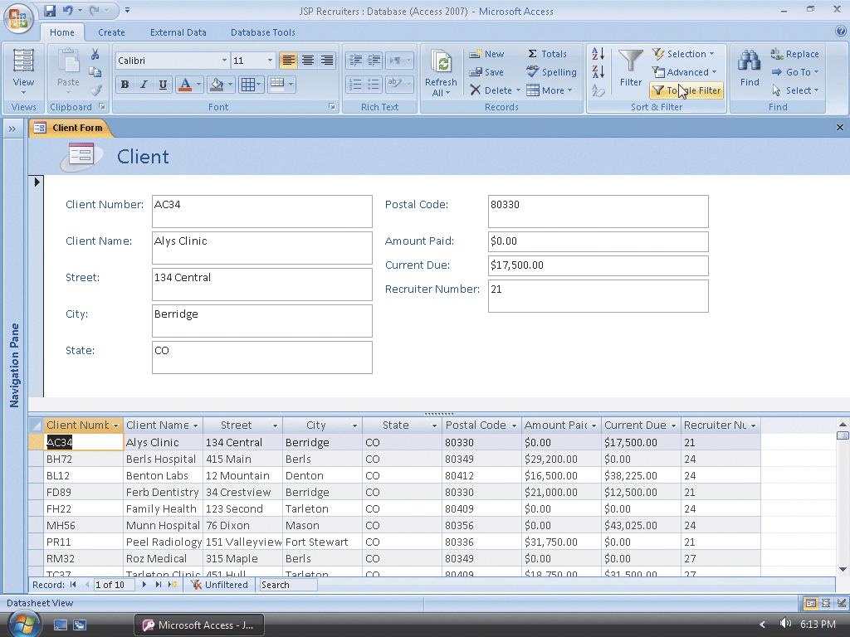
Toggling a Filter
Click the Toggle Filter button on the Home tab to toggle the filter and redisplay all records

Slide 21
Using a Common Filter
Be sure the Home tab is selected
Click the City arrow to display the common filter menu
Point to the Text Filters command to display the custom text filters
Click Begins With to display the Custom Filter dialog box

Slide 22
Using a Common Filter
Type Ber as the City begins with value
Click the OK button to filter the records
Click the Toggle Filter button on the Home tab to toggle the filter and redisplay all records

Slide 23
Using a Common Filter

Slide 24
Using Filter By Form
Click the Advanced button on the Home tab to display the Advanced menu
Click Clear All Filters on the Advanced menu to clear the existing filter
Click the Advanced button on the Home tab to display the Advanced menu a second time
Click Filter By Form on the Advanced menu

Slide 25
Using Filter By Form
Click the Postal Code field, click the arrow that appears, and then click 80330
Click the Amount Paid field, click the arrow that appears, and then click 0
Click the Toggle Filter button on the Home tab to apply the filter

Slide 26
Using Filter By Form

Slide 27
Using Advanced Filter/Sort
Click the Advanced button on the Home tab to display the Advanced menu, and then click Clear All Filters on the Advanced menu to clear the existing filter
Click the Advanced button on the Home tab to display the Advanced menu a second time
Click Advanced Filter/Sort on the Advanced menu
Expand the size of the field list so all the fields in the Client Table appear
Include the Client Number field and select Ascending as the sort order

Slide 28
Using Advanced Filter/Sort
Include the Postal Code field and enter 80330 as the criterion
Include the Amount Paid field and enter 0 as the criterion in the Criteria row and >20000 as the criterion in the Or row
Click the Toggle Filter button on the Home tab to toggle the filter and view the results. Click the Client Form tab to view the Client table
Click Clear All Filters on the Advanced menu
Close the Client Form

Slide 29
Using Advanced Filter/Sort

Slide 30
Adding a New Field
Show the Navigation pane, and then right-click the Client table to display a shortcut menu
Click Design View on the shortcut menu to open the Client table in Design view
Click the row selector for the Amount Paid field, and then press the INSERT key to insert a blank row above the Amount Paid row
Click the Field Name column for the new field. If necessary, erase any text that appears
Type Client Type as the field name and then press the TAB key

Slide 31
Adding a New Field

Slide 32
Creating a Lookup Field
If necessary, click the Data Type column for the Client Type field, and then click the arrow to display the menu of available data types
Click Lookup Wizard, and then click the ‘I will type in the values that I want.’ option button to indicate that you will type in the values
Click the Next button to display the next Lookup Wizard screen
Click the first row of the table (below Col1), and then type MED as the value in the first row
Press the DOWN ARROW key, and then type DNT as the value in the second row

Slide 33
Creating a Lookup Field
Press the DOWN ARROW key, and then type LAB as the value in the third row
Click the Next button to display the next Lookup Wizard screen
Ensure Client Type is entered as the label for the lookup column and that the Allow Multiple Values check box is NOT checked
Click the Finish button to complete the definition of the Lookup Wizard field

Slide 34
Creating a Lookup Field

Slide 35
Adding a Multivalued Field
Click the row selector for the Amount Paid field, and then press the INSERT key to insert a blank row
Click the Field Name column for the new field, type Specialties Needed as the field name, and then press the DOWN ARROW key
Click the Data Type column for the Specialties Needed field, and then click Lookup Wizard in the menu of available data types to start the Lookup Wizard
Click the ‘I will type in the values that I want.’ option button to indicate that you will type in the values
Click the Next button to display the next Lookup Wizard screen
Click the first row of the table (below Col1), and then type CLS as the value in the first row

Slide 36
Adding a Multivalued Field
Enter the remaining values from the first column in Table 3–1 on page AC 160. Before typing each value, press the TAB key to move to a new row
Click the Next button to display the next Lookup Wizard screen
Ensure Specialties Needed is entered as the label for the lookup column
Click the Allow Multiple Values check box to allow multiple values
Click the Finish button to complete the definition of the Lookup Wizard field

Slide 37
Saving the Changes and Closing the Table
Click the Save button on the Quick Access Toolbar to save the changes
Click the Close ‘Client’ button

Slide 38
Using an Updated Query
Create a new query for the Client table
Click the Update button on the Design tab, double-click the Client Type field to select the field, click the Update To row in the first column of the design grid, and then type MED as the new value
Click the Run button on the Design tab to run the query and update the records
Click the Yes button to make the changes

Slide 39
Using an Updated Query

Slide 40
Using a Delete Query
Clear the grid
Click the Delete button on the Design tab to make the query a Delete query
Double-click the Postal Code field to select the field
Click the Criteria row for the Postal Code field and type 80412 as the criterion

Slide 41
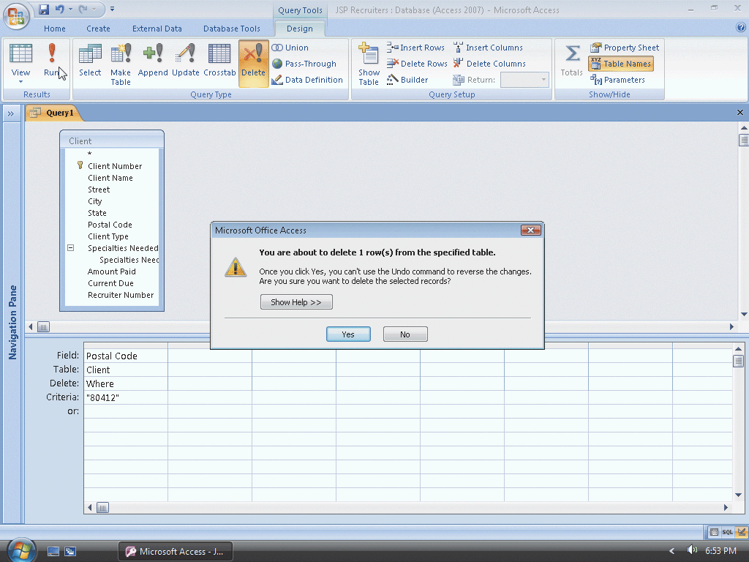
Using a Delete Query
Run the query by clicking the Run button
Click the Yes button to complete the deletion
Close the Query window. Do not save the query

Slide 42
Specifying a Required Field
Show the Navigation pane, and then open the Client table in Design view
Select the Client Name field by clicking its row selector
Click the Required property box in the Field Properties pane, and then click the down arrow that appears
Click Yes in the list

Slide 43
Specifying a Required Field

Slide 44
Specifying a Range
Select the Amount Paid field by clicking its row selector, click the Validation Rule property box to produce an insertion point, and then type >=0 and <=100000 as the rule
Click the Validation Text property box to produce an insertion point, and then type Must be at least $0.00 and at most $100,000 as the text

Slide 45
Specifying a Range

Slide 46
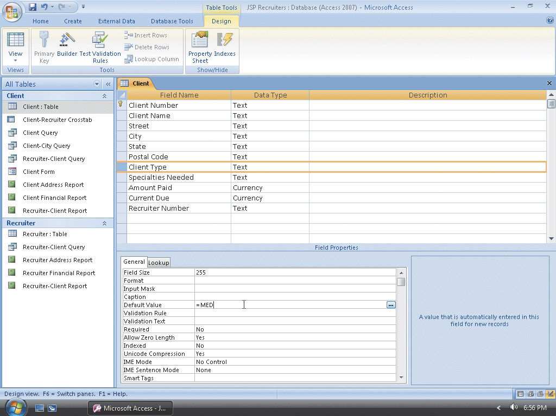
Specifying a Default Value
Select the Client Type field. Click the Default Value property box to produce an insertion point, and then type =MED as the value

Slide 47
Specifying a Collection of Allowable Values
Make sure the Client Type field is selected
Click the Validation Rule property box to produce an insertion point and then type =MED or =DNT or =LAB as the validation rule
Click the Validation Text property box and then type Must be MED, DNT, or LAB as the validation text

Slide 48
Specifying a Collection of Allowable Values

Slide 49
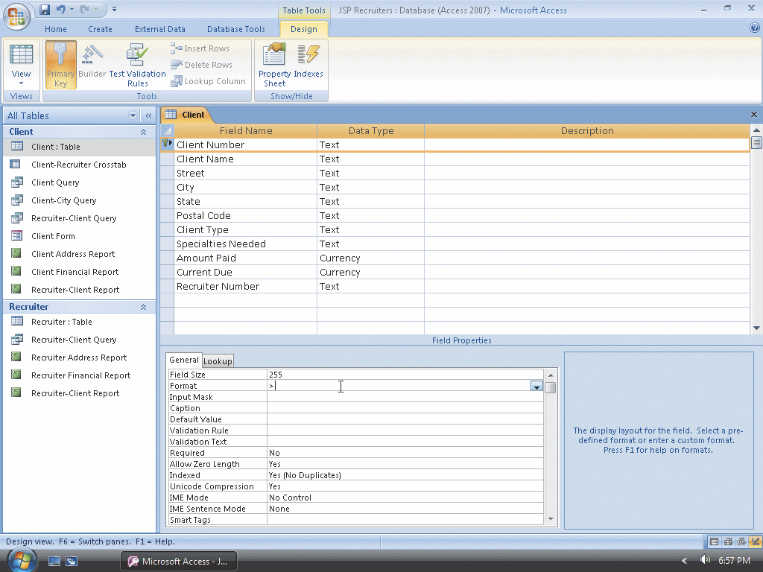
Specifying a Format
Select the Client Number field
Click the Format property box and then type >

Slide 50
Saving the Validation Rules, Default Values, and Formats
Click the Save button on the Quick Access Toolbar to save the changes
Click the No button to save the changes without testing current data
Close the Client table

Slide 51
Saving the Validation Rules, Default Values, and Formats

Slide 52
Using a Lookup Field
Open the Client table in Datasheet view and ensure the Navigation pane is hidden
Click in the Client Type field on the third record to display the arrow
Click the down arrow to display the drop-down list of available choices for the Client Type field
Click DNT to change the value
In a similar fashion, change MED on the ninth record to LAB

Slide 53
Using a Lookup Field

Slide 54
Using a Multivalued Lookup Field
Click the Specialties Needed field on the first record to display the arrow
Click the arrow to display the list of available specialties
Click the CNA, PA, Phy, and RN check boxes to select the specialties for the first client
Click the OK button to complete the selection
Using the same technique, enter the specialties given in Figure 3–47 on page AC 173 for the remaining clients

Slide 55
Using a Multivalued Lookup Field

Slide 56
Resizing a Column in a Datasheet
Point to the right boundary of the field selector for the Specialties Needed field so that the mouse pointer becomes a doubled-ended arrow
Double-click the right boundary of the field selector for the Specialties Needed field to resize the field so that it best fits the data
Use the same technique to resize all the other fields to best fit the data. To resize the Amount Paid, Current Due, and Recruiter Number fields, you will need to scroll the fields by clicking the right scroll arrow shown in Figure 3–52 on page AC 175
Save the changes to the layout by clicking the Save button on the Quick Access Toolbar
Close the Client table

Slide 57
Resizing a Column in a Datasheet

Slide 58
Including Totals in a Datasheet
Open the Recruiter table in Datasheet view and hide the Navigation pane
Click the Totals button on the Home tab to include the Total row in the datasheet
Click the Total row in the Commission column to display an arrow
Click the arrow to display a menu of available computations

Slide 59
Including Totals in a Datasheet
Click Sum to calculate the sum of the commissions
Click the Total row in the Rate column to display an arrow
Click the arrow to display a menu of available computations
Click Average to calculate the average of the rates

Slide 60
Including Totals in a Datasheet

Slide 61
Removing Totals from a Datasheet
Click the Totals button on the Home tab to remove the Total row from the datasheet

Slide 62
Changing Gridlines in a Datasheet
Open the Recruiter table in Datasheet view, if it is not already open
Click the box in the upper-left corner of the Datasheet selector to select the entire datasheet
Click the Gridlines button on the Home tab to display the Gridlines gallery
Click the Gridlines: Horizontal command in the Gridlines gallery to include only horizontal gridlines

Slide 63
Changing Gridlines in a Datasheet

Slide 64
Changing the Colors and Font in a Datasheet
With the datasheet for the Recruiter table selected, click the Alternate Fill/Back Color button arrow to display the color palette
Click Aqua Blue (the second from the right color in the standard colors) to select aqua blue as the alternate color
Click the Font Color arrow, and then click Red (the second color in the bottom row) in the lower-left corner of standard colors to select Red as the font color
Click the Font box arrow, and then select Bodoni MT as the font. (If it is not available, select any font of your choice.)
Click the Font Size box arrow and select 10 as the font size

Slide 65
Changing the Colors and Font in a Datasheet

Slide 66
Closing the Datasheet Without Saving the Format Changes
Click the Close ‘Recruiter’ button to close the Recruiter table
Click the No button in the Microsoft Office Access dialog box when asked if you want to save your changes

Slide 67
Querying a Multivalued Field Showing Multiple Values on a Single Row
Create a query for the Client table and hide the Navigation pane
Include the Client Number, Client Name, Client Type, and Specialties Needed fields
View the results

Slide 68
Querying a Multivalued Field Showing Multiple Values on a Single Row

Slide 69
Querying a Multivalued Field Showing Multiple Values on Multiple Rows
Return to Design view and ensure the Client Number, Client Name, Client Type, and Specialties Needed fields are selected
Click the Specialties Needed field to produce an insertion point, and then type a period and the word Value after the word, Needed, to use the Value property
View the results
Close the query by clicking the Close ‘Query1’ button
When asked if you want to save the query, click the No button

Slide 70
Querying a Multivalued Field Showing Multiple Values on Multiple Rows

Slide 71
Specifying Referential Integrity
Click Database Tools on the Ribbon to display the Database Tools tab
Click the Relationships button on the Database Tools tab to open the Relationships window and display the Show Table dialog box
Click the Recruiter table and then click the Add button to add the Recruiter table
Click the Client table and then click the Add button to add the Client table

Slide 72
Specifying Referential Integrity
Click the Close button in the Show Table dialog box to close the dialog box
Resize the field lists that appear so all fields are visible
Drag the Recruiter Number field in the Recruiter table field list to the Recruiter Number field in the Client table field list to open the Edit Relationships dialog box to create a relationship
Click the Enforce Referential Integrity check box

Slide 73
Specifying Referential Integrity
Click the Cascade Update Related Fields check box
Click the Create button to complete the creation of the relationship
Click the Save button on the Quick Access Toolbar to save the relationship you created
Close the Relationships window by clicking the Close ‘Relationships’ button

Slide 74
Specifying Referential Integrity

Slide 75
Using a Subdatasheet
Open the Recruiter table and hide the Navigation pane
Click the plus sign in front of the row for Recruiter 24 to display the subdatasheet
Close the datasheet for the Recruiter table

Slide 76
Using a Subdatasheet

Slide 77
Using the Ascending Button to Order Records
Open the Client table in Datasheet view and hide the Navigation pane
Click the City field on the first record to select the field
Click the Ascending button on the Home tab to sort the records by City
Close the table. When asked if you want to save your changes, click the No button

Slide 78
Using the Ascending Button to Order Records

Slide 79
Quitting Access
Click the Close button on the right side of the Access title bar to quit Access

Slide 80
Summary
Add, change, and delete records
Search for records
Filter records
Update a table design
Format a datasheet
Use action queries to update records

Slide 81
Summary
Specify validation rules, default values, and formats
Create and use single-valued and multivalued Lookup fields
Specify referential integrity
Use a subdatasheet
Sort records

Slide 82
Access Chapter 3 Complete

