Slide 1
Access Chapter 6
Using Macros, Switchboards, PivotTables, and PivotCharts

Slide 2
Objectives
Create and modify macros and macro groups
Run macros
Create a switchboard and switchboard pages
Modify switchboard pages
Use a switchboard
Import data and create a query
Create a PivotTable

Slide 3
Objectives
Change properties in a PivotTable
Use a PivotTable
Create a PivotChart and add a legend
Change the chart type and organization of a PivotChart
Remove drop zones in a PivotChart
Assign axis titles and a chart title in a PivotChart
Use a PivotChart

Slide 4
Plan Ahead
Determine when it would be beneficial to automate tasks in a macro
Determine whether it is appropriate to create a switchboard
Determine the organization of the switchboard
Determine whether it is appropriate to present data as a PivotTable
Determine the organization of the PivotTable
Determine whether it is appropriate to present data as a PivotChart
Determine the organization of the PivotChart

Slide 5
Begin Creating a Macro
Start Access and open the JSP Recruiters database as described on pages AC 365 – 366
If necessary, hide the Navigation Pane
Click Create on the Ribbon to display the Create tab
Click the Macro button arrow to display the Macro button menu
Click Macro on the Macro menu to create a new macro

Slide 6
Begin Creating a Macro

Slide 7
Adding Actions to a Macro
Click the box arrow in the first row of the Action column to display a menu of available actions
Scroll down until OpenTable appears and then click OpenTable to select it as the action
Click the Table Name argument to display an arrow
Click the arrow to display a list of available tables and then click Client to select the Client table
Click the Data Mode argument to display an arrow

Slide 8
Adding Actions to a Macro
Click the arrow to display a list of available choices for the Data Mode argument
Click Read Only to select Read Only as the value for the Data Mode argument
Click the second row in the Action column and then click the arrow that appears to display a menu of available actions
Scroll down until MsgBox appears and then click MsgBox to select it as the action
Click the Message argument and type Table is open as read-only as the message

Slide 9
Adding Actions to a Macro
Click the Type argument, click the arrow that appears, and then select Information as the value for the Type argument
Click the Save button on the Quick Access Toolbar and type Open Client Table Read Only as the name of the macro
Click the OK button to save the macro
Close the macro

Slide 10
Adding Actions to a Macro

Slide 11
Running a Macro
Show the Navigation Pane and scroll down, if necessary, so that the Open Client Table Read Only macro appears. It should be in a section of the Navigation Pane called Unrelated Objects, because it is not directly related to any of the tables in the database
Right-click the Open Client Table Read Only macro and then click Run on the shortcut menu to run the macro
Click the OK button in the JSP Recruiters dialog box and then close the Client table

Slide 12
Running a Macro

Slide 13
Modifying a Macro
Right-click the Open Client Table Read Only macro to display a shortcut menu
Click Design View on the shortcut menu to open the macro in Design view
Click the row selector on the row containing the MsgBox action to select the row, and then press the INSERT key to insert a new row
Click the new row
Click the Action column arrow on the new row, scroll down, and select NavigateTo as the action

Slide 14
Modifying a Macro
Click the Category argument, click the arrow, and then click Object Type as the value for the Category argument
Click the Group argument, click the arrow, and then click Tables as the value for the Group argument
Save and then close the macro

Slide 15
Modifying a Macro

Slide 16
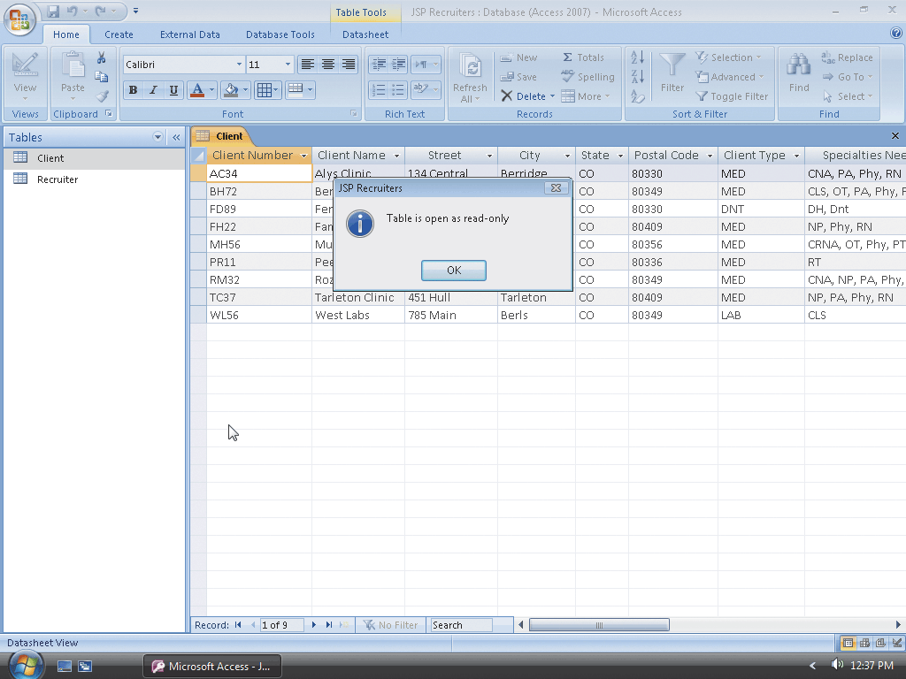
Running the Modified Macro
Right-click the Open Client Table Read Only macro and then click Run on the shortcut menu to run the macro
Click the OK button in the JSP Recruiters dialog box and then close the Client table

Slide 17
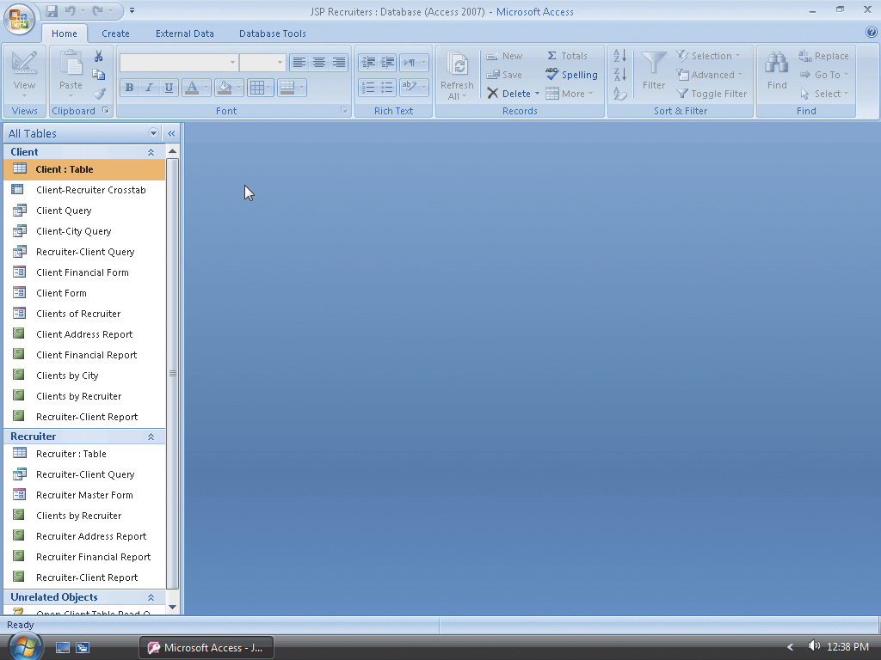
Reversing the Macro Action
Click the Navigation Pane arrow to produce the Navigation Pane menu
Click Tables and Related Views to once again organize the Navigation Pane by table

Slide 18
Creating a Macro Group
Click Create on the Ribbon to display the Create tab
Click the Macro button arrow to display the Macro menu
Click Macro on the Macro menu to create a new macro
Hide the Navigation Pane
Click the Macro Names button on the Design tab to display the Macro Name column

Slide 19
Creating a Macro Group
Type the name of the first macro in Table 6–2 on page AC 376 in the Macro Name column on the first row
In the Action column on the first row, select the first action in the first macro in Table 6–2 and then make the indicated changes to the arguments in the Actions Arguments pane at the bottom of the screen
In the Action column on the second row, select the second action in the first macro in Table 6–2 and then make the indicated changes to the arguments

Slide 20
Creating a Macro Group

Slide 21
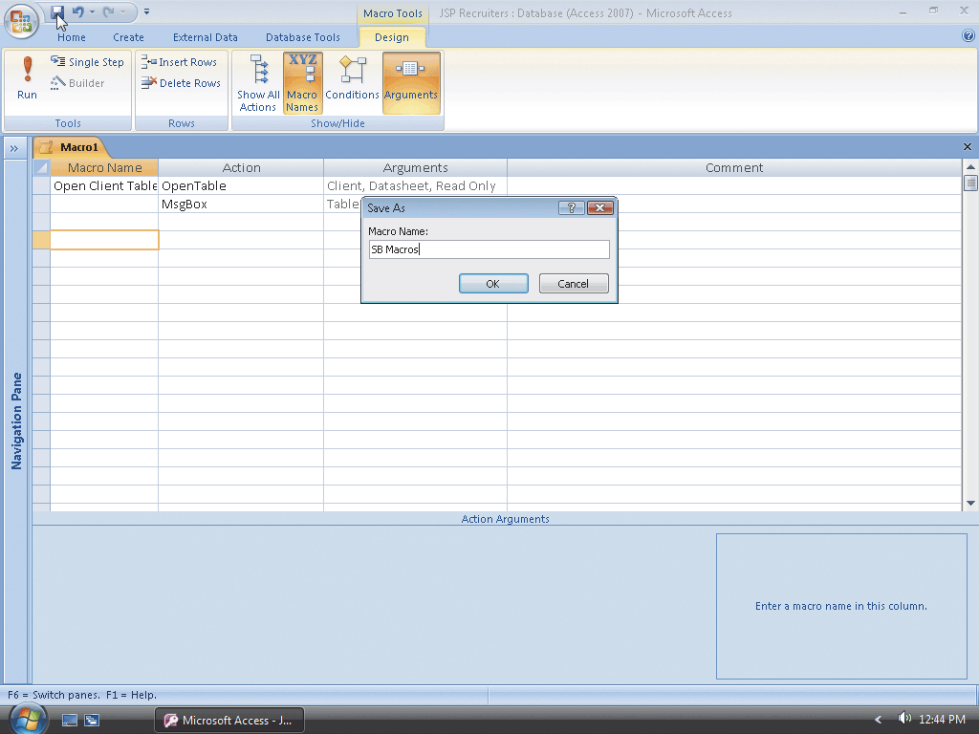
Saving the Macro Group
Click the Save button on the Quick Access Toolbar to display the Save As dialog box
Type SB Macros as the macro name
Click the OK button to save the macro group

Slide 22
Adding the Remaining Macros to the Macro Group
Enter the remaining macro names, actions, and arguments shown in Table 6–2 on pages AC 372 and AC 373
Click the Save button on the Quick Access Toolbar to save the macro group with the additional macros
Close the macro group

Slide 23
Adding the Remaining Macros to the Macro Group

Slide 24
Creating a Switchboard
Hide the Navigation Pane if it is not already hidden
Click Database Tools on the Ribbon to display the Database Tools tab
Click the Switchboard Manager button on the Database Tools tab
Click the Yes button to create a new switchboard

Slide 25
Creating a Switchboard

Slide 26
Creating Switchboard Pages
Click the New button in the Switchboard Manager dialog box
Type View Form as the name of the new switchboard page
Click the OK button to create the View Form switchboard page
Use the same technique to create the View Table, View Report, and Print Report switchboard pages

Slide 27
Creating Switchboard Pages

Slide 28
Modifying the Main Switchboard Page
With the Main Switchboard (Default) page selected, click the Edit button to edit the Main switchboard
Click the New button, type View Form as the text, and then click the Switchboard box arrow to display a menu of available switchboards
Click View Form and then click the OK button to add the item to the switchboard
Using the technique illustrated in the previous steps, add the View Table, View Report, and Print Report items to the Main Switchboard page. In each case, the command is Go to Switchboard. The names of the switchboards are the same as the name of the items. For example, the switchboard for the View Table item is called View Table

Slide 29
Modifying the Main Switchboard Page
Click the New button, type Exit Application as the text, and click the Command box arrow to display a menu of available commands
Click Exit Application and then click the OK button to add the item to the switchboard
Click the Close button in the Edit Switchboard Page dialog box to indicate you have finished editing the Main Switchboard page

Slide 30
Modifying the Main Switchboard Page

Slide 31
Modifying the Other Switchboard Pages
Click the View Form switchboard
Click the Edit button, click the New button to add a new item, type Client Form as the text, click the Command box arrow, and then click Run Macro
Click the Macro box arrow to display a menu of available macros
Click Open Client Form, and then click the OK button
Click the New button, type Recruiter Master Form as the text, click the Command box arrow, and then click Run Macro
Click the Macro box arrow, click Open Recruiter Master Form, and then click the OK button

Slide 32
Modifying the Other Switchboard Pages
Click the New button, type Return to Main Switchboard as the text, and click the Switchboard box arrow
Click Main Switchboard in the list of available switchboards, and then click the OK button
Click the Close button in the Edit Switchboard Page dialog box to indicate you have finished editing the View Form switchboard
Use the techniques illustrated in the previous steps to add the items indicated in Table 6–3 on page AC 381 to the other switchboards
Click the Close button in the Switchboard Manager dialog box

Slide 33
Modifying the Other Switchboard Pages

Slide 34
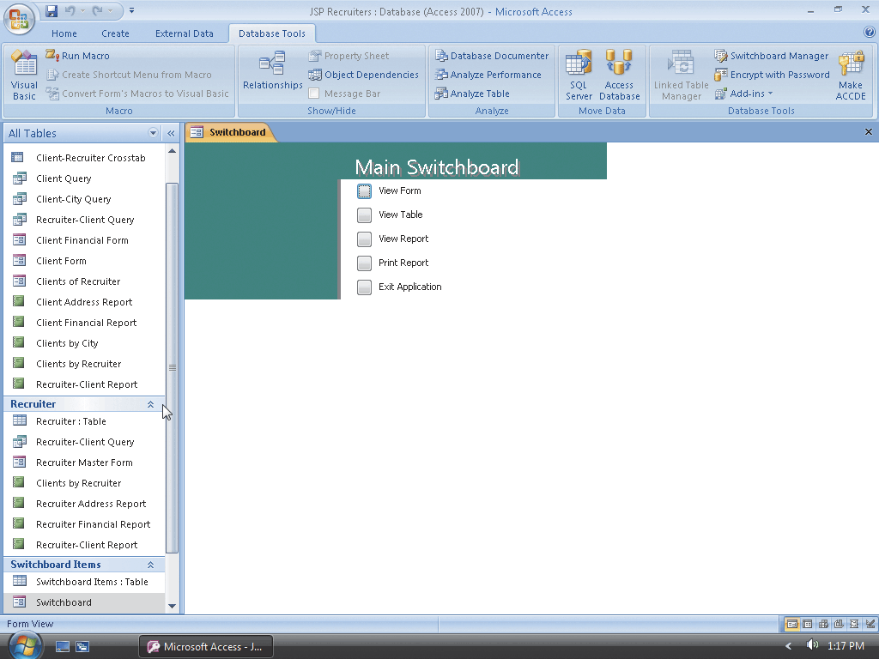
Opening a Switchboard
Show the Navigation Pane, scroll down so that the Switchboard form appears, and then right-click Switchboard
Click Open on the shortcut menu to open the switchboard

Slide 35
Closing the Switchboard and Closing the Database
Click the Exit Application button to remove the switchboard from the screen and close the database

Slide 36
Importing the Data
Follow the steps on pages AC 390 – 391 to open the JSP Recruiters database and create the new tables
With the JSP Recruiters database open, click the External Data tab on the Ribbon and then click the Text File button in the Import group on the External Data tab to display the Get External Data - Text File dialog box
Click the Browse button and select the location of the files to be imported (for example, the folder called AccessData on drive E:). Select the Seminar text file and click the Open button
Select the ‘Append a copy of records to the table’ option button and the Seminar table and then click the OK button. Be sure the Delimited option button is selected and click the Next button. Click First Row Contains Field Names check box, click the Next button, and then click the Finish button
Click the Close button to close the Get External Data – Text Box dialog box without saving the import steps
Use the technique shown in the previous steps to import the Seminar Offerings text file into the Seminar Offerings table

Slide 37
Relating Several Tables
Close any open datasheet on the screen by clicking its Close button. Click Database Tools on the Ribbon to display the Database Tools tab and then click the Relationships button on the Database Tools tab
Click the Show Table button
Click the Seminar Offerings table, click the Add button, click the Seminar table, click the Add button again, and then click the Close button
Point to the Client Number field in the Client table, press the left mouse button, drag to the Client Number in the Seminar Offerings table, and then release the left mouse button. Click the Enforce Referential Integrity check box in the Edit Relationships dialog box and then click the Create button
Drag the Seminar Number field from the Seminar table to the Seminar Offerings table. Click Enforce Referential Integrity check box and then click the Create button to create the relationship
Click the Close button in the Relationships group and then click the Yes button to save the changes

Slide 38
Relating Several Tables

Slide 39
Creating the Query
Click Create on the Ribbon and then click the Query Design button on the Create tab to create a query
Click the Recruiter table and then click the Add button to add the Recruiter table to the query
Click the Client table and then click the Add button to add the Client table to the query
Click the Seminar Offerings table and then click the Add button to add the Seminar Offerings table to the query
Click the Close button for the Show Table dialog box
Resize the Recruiter and Client field lists so as many fields as possible appear
Double-click the Recruiter Number field from the Recruiter table and the Client Number field from the Client table

Slide 40
Creating the Query
Double-click the Seminar Number and Hours Spent fields from the Seminar Offerings table
Right-click the Field row in the first open column to produce a shortcut menu
Click Zoom on the shortcut menu to display the Zoom dialog box, type Hours Remaining:[Total Hours]-[Hours Spent] in the Zoom dialog box to enter the expression for the field
Click the OK button and then click the View button on the Design tab to ensure your results are correct
Click the Save button on the Quick Access Toolbar and type Recruiters and Seminar Offerings as the name of the query
Click the OK button to save the query
Close the query

Slide 41
Creating the Query

Slide 42
Creating a PivotTable
Show the Navigation Pane, right-click the Recruiters and Seminar Offerings query, click Open on the shortcut menu, and then hide the Navigation Pane
Click the View button arrow to display the View button menu
Click PivotTable View to switch to PivotTable view of the query
If the PivotTable Field List does not appear, click the Field List button on the PivotTable tab to display the field list
Click Seminar Number in the field list, and then ensure Row Area appears next to the Add to button
Click the Add to button to add the Seminar Number field to the Row area

Slide 43
Creating a PivotTable
Click the Add to box arrow to display the list of available areas
Click Column Area, click the Recruiter Number field in the field list, and then click the Add to button to add the Recruiter Number field to the Column area
Click the arrow to display the list of available areas, click Data Area, click Hours Spent, and then click the Add to button to add the Hours Spent field to the Data area
Use the same technique to add the Hours Remaining field to the Data area
Close the PivotTable Field List by clicking its Close button

Slide 44
Creating a PivotTable

Slide 45
Changing Properties in a PivotTable
Click the Sum of Hours Spent box to select it, and then click the Property Sheet button on the Design tab to display a property sheet
Click the Captions tab in the property sheet
Delete the current entry in the Caption property box, type Spent as the new value for the Caption property, and then close the property sheet
Use the same technique to change the caption for the Sum of Hours Remaining box to Remaining

Slide 46
Changing Properties in a PivotTable

Slide 47
Saving the PivotTable Changes
Click the Save button on the Quick Access Toolbar

Slide 48
Using a PivotTable
Click the View button arrow, and then click PivotTable View
Click the plus sign (+) under recruiter number 21 to remove the details for recruiter number 21
Click the minus sign (–) under recruiter number 21 to again display data for recruiter number 21
Click the Recruiter Number arrow to display a list of available recruiter numbers
Click the Check box for recruiter number 21 to remove the check mark, and then click the OK button to remove the data for recruiter number 21
Click the Recruiter Number arrow, click the All check box to display all recruiter numbers, and then click the OK button

Slide 49
Using a PivotTable
Click the Field List button to display the PivotTable Field List. Click Client Number, click the arrow to display a list of available areas, click Filter Area, and then click the Add to button to add the Client Number field to the Filter area
Click the Client Number arrow
Click the check boxes in front of clients BH72 and FH22 to remove the check marks, and then click the OK button so that the data for these clients will not be reflected in the PivotTable
Click the Client Number arrow, click the All check box, and then click the OK button to display data for all clients
Drag the Recruiter Number field from the Column area to the Row area, and then drag Seminar Number field from the Row area to the Column area to reverse the organization
Close the Recruiters and Seminar Offerings query without saving your changes

Slide 50
Using a PivotTable

Slide 51
Creating a PivotChart and Adding a Legend
Show the Navigation Pane if it is currently hidden
Open the Recruiters and Seminar Offerings query
Hide the Navigation Pane
Click the View button arrow, and then click PivotChart View
If the Chart Field List appears, close the field list by clicking its Close button
Click the Legend button on the Design tab to display a legend

Slide 52
Creating a PivotChart and Adding a Legend

Slide 53
Changing the Chart Type
If the Change Chart Type button is dimmed, click the Chartspace (that is, the white space in the chart)
Click the Change Chart Type button on the Design tab, and then, if necessary, click the Type tab to display the available chart
Click the 3D Stacked Column type to change the chart type, and then close the Properties window by clicking its Close button

Slide 54
Changing the Chart Type

Slide 55
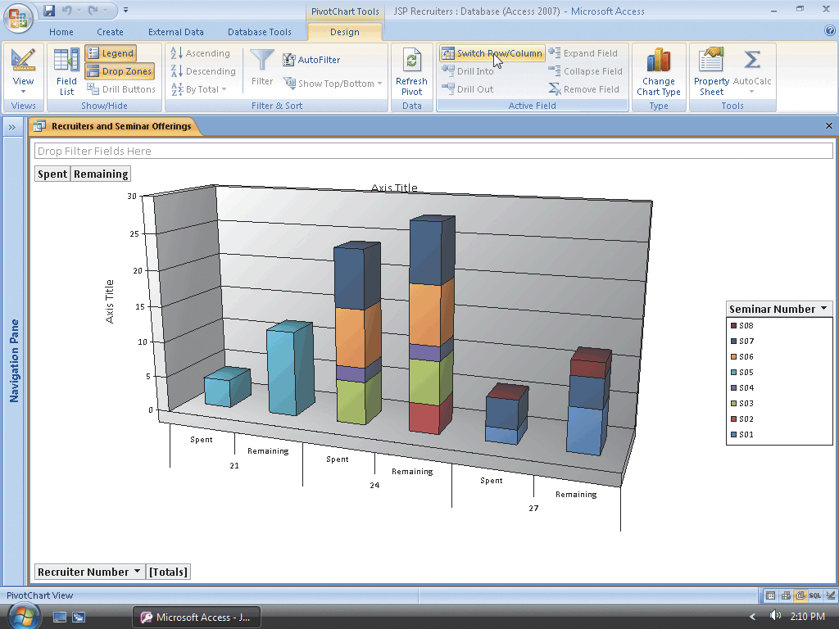
Changing PivotChart Orientation
Click the Switch Row/Column button on the Design tab to change the organization

Slide 56
Assigning Axis Titles
Click the axis title to the left of the chart, and then click the Property Sheet button on the Design tab
Click the Format tab in the Properties window, and then click the Caption box
Use the BACKSPACE or DELETE key to delete the old caption
Type Hours as the new caption
Close the property sheet to complete the change of the axis title
Use the same technique to change the other axis title to Recruiter

Slide 57
Assigning Axis Titles

Slide 58
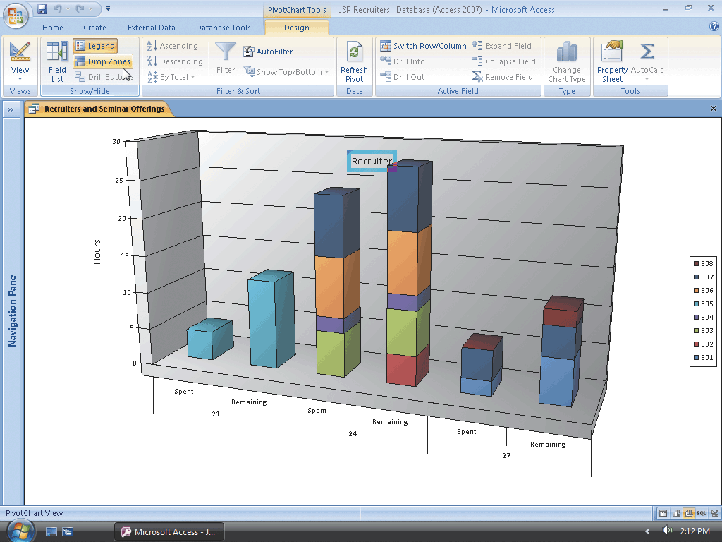
Removing Drop Zones
Click the Drop Zones button on the Design tab to remove the drop zones

Slide 59
Adding a Chart Title
Click anywhere in the Chartspace (the white space) of the PivotChart, click Property Sheet button on the Design tab, and then, if necessary, click the General tab
Click the Add Title button
Close the property sheet, click the newly added title, and then click the Property Sheet button on the Design tab
Click the Format tab

Slide 60
Adding a Chart Title
Click the Caption box, and then use the BACKSPACE or DELETE key to erase the old caption
Type Hours by Recruiter and Seminar as the new caption and press the ENTER key to change the caption
Close the property sheet by clicking its Close button

Slide 61
Adding a Chart Title

Slide 62
Using the PivotChart
Be sure the Recruiters and Seminar Offerings query is open in PivotChart view
Click the Drop Zones button on the Design tab to display the drop zones
Click the Recruiter Number arrow to display the list of available recruiters
Click the check box for recruiter number 24 to remove the check mark, and then click the OK button
Close the PivotChart without saving your changes

Slide 63
Using the PivotChart

Slide 64
Summary
Create and modify macros and macro groups
Run macros
Create a switchboard and switchboard pages
Modify switchboard pages
Use a switchboard
Import data and create a query
Create a PivotTable

Slide 65
Summary
Change properties in a PivotTable
Use a PivotTable
Create a PivotChart and add a legend
Change the chart type and organization of a PivotChart
Remove drop zones in a PivotChart
Assign axis titles and a chart title in a PivotChart
Use a PivotChart

Slide 66
Access Chapter 6 Complete

