Slide 1
Access 2007 Chapter 7
Advanced Report Techniques

Slide 2
Objectives
Change a caption
Create queries for reports
Create reports in Design view
Add fields and text boxes to a report
Format controls
Group and ungroup controls

Slide 3
Objectives
Update multiple controls
Add and modify a sub-report
Modify section properties
Add a title, page number, and date
Add totals and subtotals
Create and print mailing labels

Slide 4
Plan Ahead
Determine the intended audience and purpose of the report
Determine the source of data for the report
Determine the fields that belong on the report
Determine the organization of the report
Determine any calculations required for the report
Determine the format and style of the report
For mailing labels, determine the contents, order, and type of label

Slide 5
Starting Access
Note: If you are using Windows XP, refer to Appendix F for alternate steps
Click the Start button on the Windows Vista taskbar to display the Start menu
Click All Programs at the bottom of the left pane on the Start menu to display the All Programs list, and then click Microsoft Office on the All Programs list to display the Microsoft Office list
Click Microsoft Office Access 2007 on the Microsoft Office list to start Access and display the Getting Started with Microsoft Office Access window
If the Access window is not maximized, click the Maximize button on its title bar to maximize the window

Slide 6
Opening a Database
Note: If you are using Windows XP, refer to Appendix F for alternate steps
With your USB fl ash drive connected to one of the computer’s USB ports, click the More button to display the Open dialog box
If the Folders list is displayed below the Folders button, click the Folders button to remove the Folders list
If necessary, click Computers in the Favorite Links section and then double-click UDISK 2.0 (E:) to select the USB fl ash drive, Drive E in this case as the new open location. (Your drive letter might be different)
Click JSP Recruiters to select the file name

Slide 7
Opening a Database
Click the Open button to open the database
If a Security Warning appears, click the Options button to display the Microsoft Office
Security Options dialog box
With the option button to enable the content selected, click the OK button to enable the content

Slide 8
Changing a Caption
Open the Client table in Design view
Click the row selector for the Specialties Needed field to select the field
Click the Caption property box and then type Spec Needed as the new caption
Click the Save button on the Quick Access Toolbar to save the change
Close the Client table

Slide 9
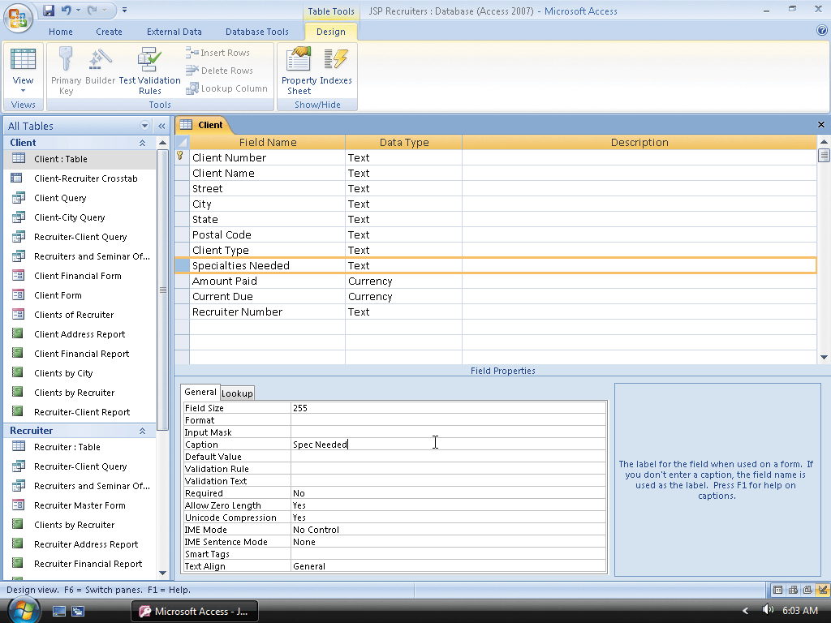
Changing a Caption

Slide 10
Creating a Query for the Report
Hide the Navigation Pane, click Create on the Ribbon to display the Create tab, and then click the Query Design button on the Create tab to create a new query
Click the Recruiter table, click the Add button, click the Client table, click the Add button, and then click the Close button to close the Show Table dialog box Double-click the Recruiter Number, First Name, and Last Name fields from the Recruiter table
Double-click the Client Number, Client Name, Street, City, State, Postal Code, Client Type, Specialties Needed, Amount Paid, and Current Due fields from the Client table to add the fields to the design grid
View the query results and scroll through the fields to make sure you have included all the necessary fields. If you have omitted a field, return to Design view and add it
Click the Save button on the Quick Access Toolbar to save the query, type Recruiters and Clients as the name of the query, and then click the OK button
Close the query

Slide 11
Creating an Additional Query for the Report
Click Create on the Ribbon to display the Create tab and then click the Query Design button on the Create tab to create a new query
Click the Seminar table, click the Add button, click the Seminar Offerings table, click the Add button, and then click the Close button to close the Show Table dialog box
Double-click the Client Number and Seminar Number fields from the Seminar Offerings table. Double click the Seminar Description field from the Seminar table. Double-click the Total Hours and Hours Spent fields from the Seminar
Offerings table to add the fields to the design grid
Click the first open column in the design grid to select it
Click the Builder button on the Design tab to display the Expression Builder dialog box

Slide 12
Creating an Additional Query for the Report
Double-click Tables to display a list of tables, and then click the Seminar Offerings table to select it
Click the Total Hours field to select it and then click the Paste button to paste it into the expression
Click the minus sign to add it to the expression
Click the Hours Spent field to select it and then click the Paste button to paste it into the expression
Click the OK button and then press the ENTER key to enter the expression

Slide 13
Creating an Additional Query for the Report
Click the field in the grid in which you entered the expression and then click the Property Sheet button on the Design tab to display the property sheet
Click the Caption property box and type Hours Remaining as the caption
Close the property sheet and then view the results of the query
Verify that your query results match those in the figure. If not, return to Design view and make the necessary corrections
Click the Save button, type Seminar Offerings and Seminars as the name of the query, and then click the OK button to save the query
Close the query

Slide 14
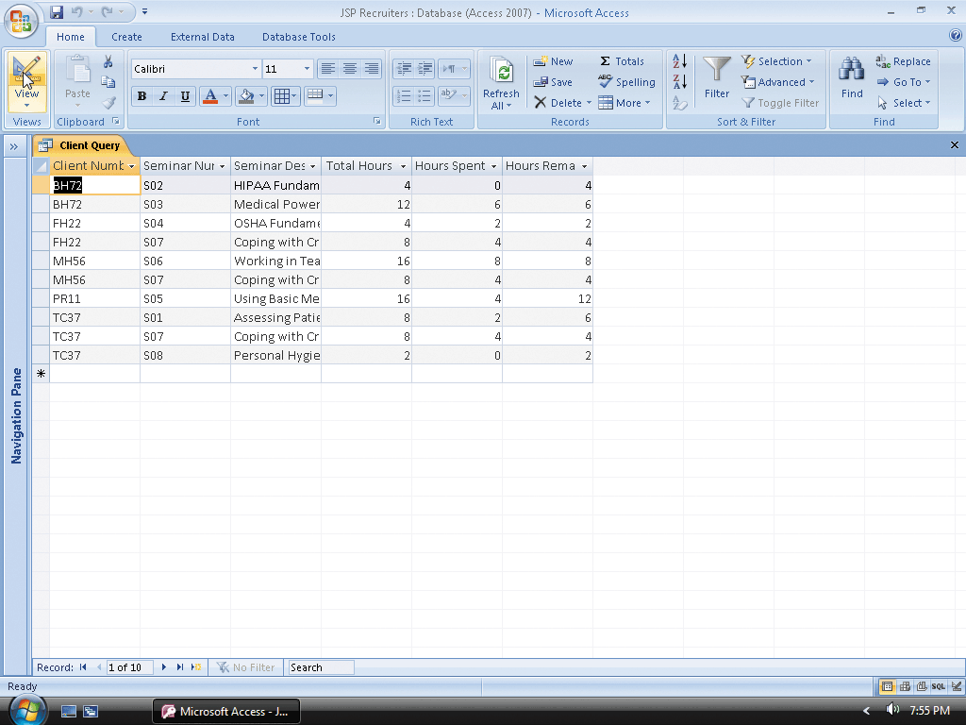
Creating an Additional Query for the Report

Slide 15
Creating an Initial Report in Design View
Click Create on the Ribbon to display the Create tab
Click the Report Design button on the Create tab to create a report in Design view
Ensure the selector for the entire report, the box in the upper-left corner of the report, is selected
Click the Property Sheet button on the Design tab to display a property sheet
With the All tab selected, click the Record Source property box arrow to display the list of available tables and queries
Click the Recruiters and Clients query to select the query as the record source for the report

Slide 16
Creating an Initial Report in Design View
Close the property sheet by clicking the Property Sheet button on the Design tab
Click the Group & Sort button to display the Group, Sort, and Total pane
Click the ‘Add a group’ button to display the list of available fields for grouping
Click the Recruiter Number field to group by Recruiter Number
Click the ‘Add a sort’ button to display the list of available fields for sorting
Click the Client Number field to sort by Client Number

Slide 17
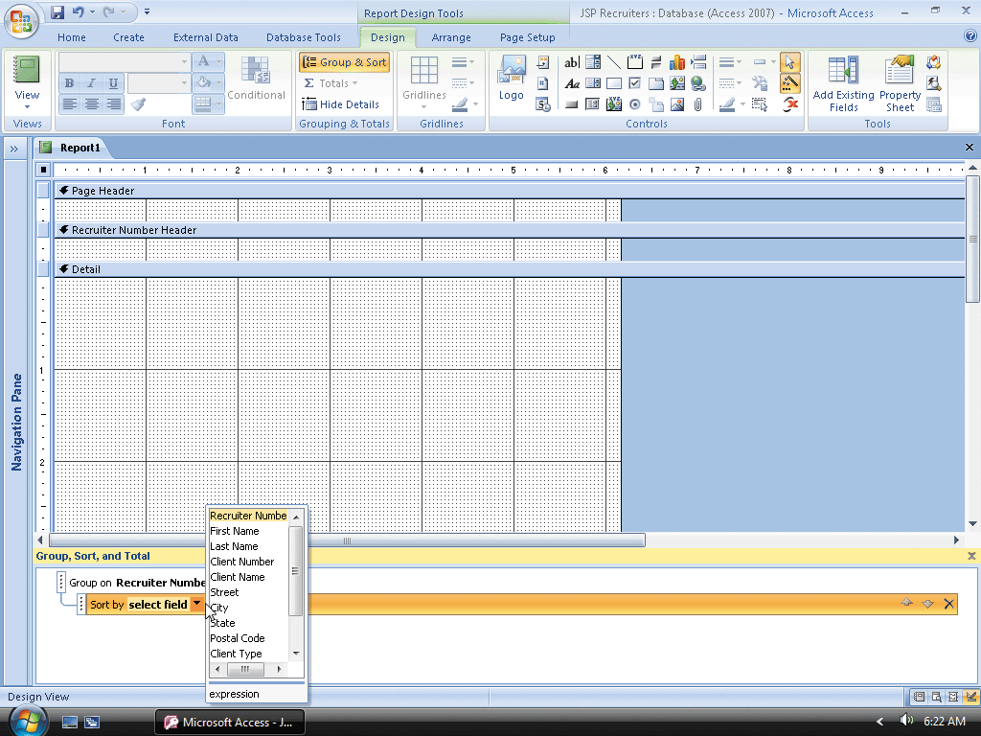
Creating an Initial Report in Design View

Slide 18
Saving the Report
Click the Save button
Type Recruiter Master List as the report name
Click the OK button

Slide 19
Adding Fields to the Report
Click the Add Existing Fields button on the Design tab to add a field list
Drag the Recruiter Number field to the approximate position
Release the left mouse button to place the field
Place the remaining fields in the positions
Click Arrange on the Ribbon to display the Arrange tab

Slide 20
Adding Fields to the Report
Adjust the positions of the labels to those shown in the figure. If any field is not in the correct position, drag it to its correct location. To move the control or the attached label separately, drag the large handle in the upper-left corner of the control or label
Click Design on the Ribbon to display the Design tab
Remove the field list by clicking the Add Existing Fields button
Remove the Group, Sort, and Total pane by clicking the Group & Sort button on the Design tab

Slide 21
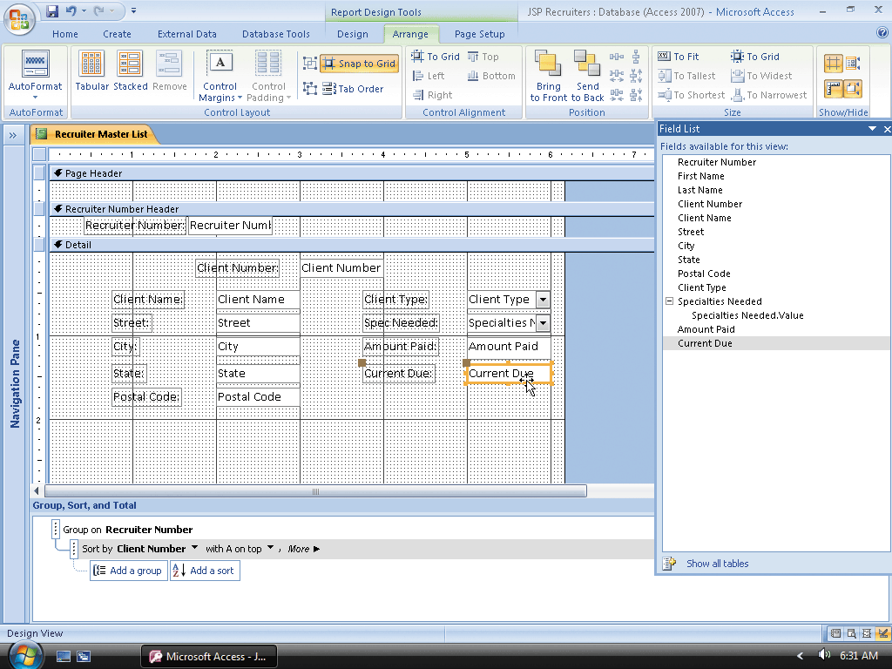
Adding Fields to the Report

Slide 22
Adding Text Boxes
Click the Text Box tool on the Design tab and move the pointer to the approximate position
Click the position to place a text box on the report
Click in the text box to produce an insertion point
Type =[First Name] &' '&[Last Name] as the entry in the text box
Click in the attached label to produce an insertion point

Slide 23
Adding Text Boxes
Use the BACKSPACE or DELETE key to erase the current entry in the label except for the colon and then type Recruiter Name prior to the colon as the new entry
Click outside the label to deselect it and then drag the label to the position shown in the figure by dragging the Move handle in the upper-left corner of the label
Use the techniques in Steps 1 to 5 to place a text box in the position indicated in Figure 7–20. Type =[Amount Paid]+[Current Due] as the expression in the text box, drag the label to the position shown in the figure, erase the contents of the label other than the colon and type Total Amount in the label

Slide 24
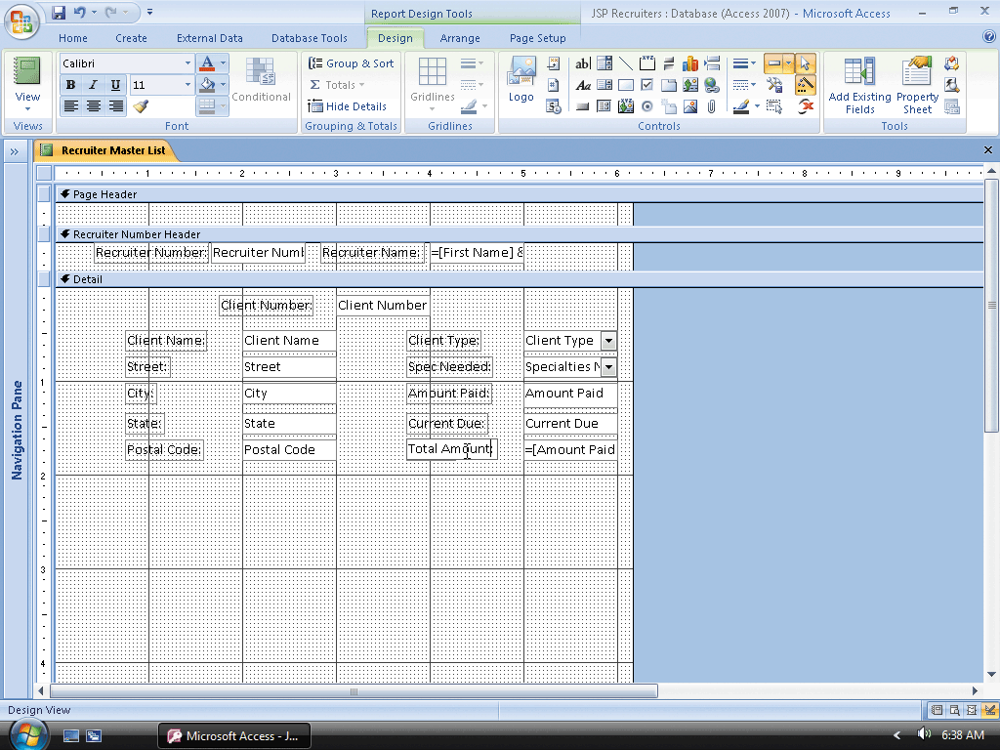
Adding Text Boxes

Slide 25
Viewing the Report
Click the View button arrow to produce the View button menu
Click Print Preview on the View button menu to view the report in Print Preview
Click the Close Print Preview button on the Print Preview tab to return to Design view

Slide 26
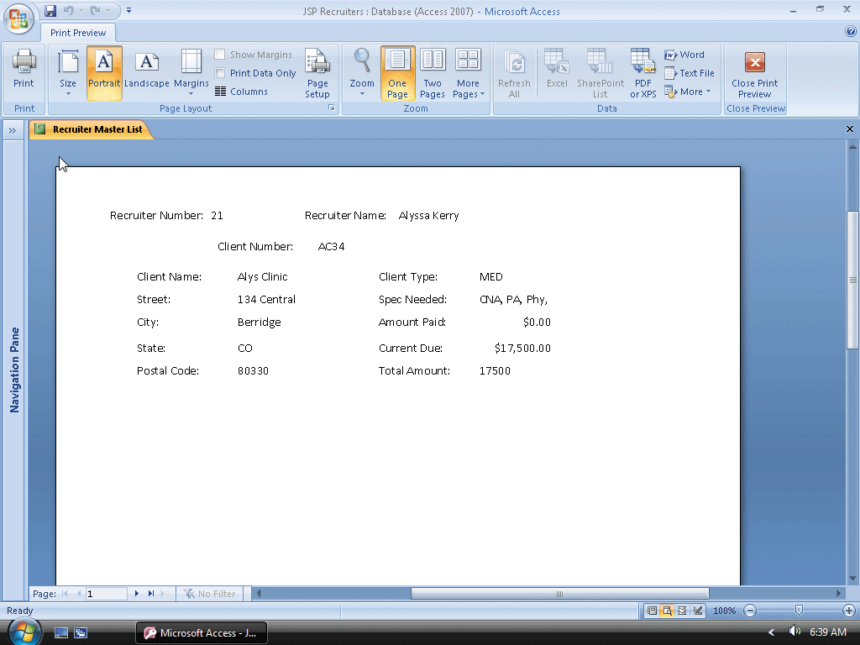
Viewing the Report

Slide 27
Formatting a Control
Click the control containing the expression for Total Amount to select it and then click the Property Sheet button on the Design tab to display the property sheet
If necessary, click the All tab
Click the Format property box, click the arrow that appears, and then click Currency to select Currency as the format
Click the Decimal Places property box, click the arrow that appears, and then click 2 to select 2 as the number of decimal places
Remove the property sheet by clicking the Property Sheet button

Slide 28
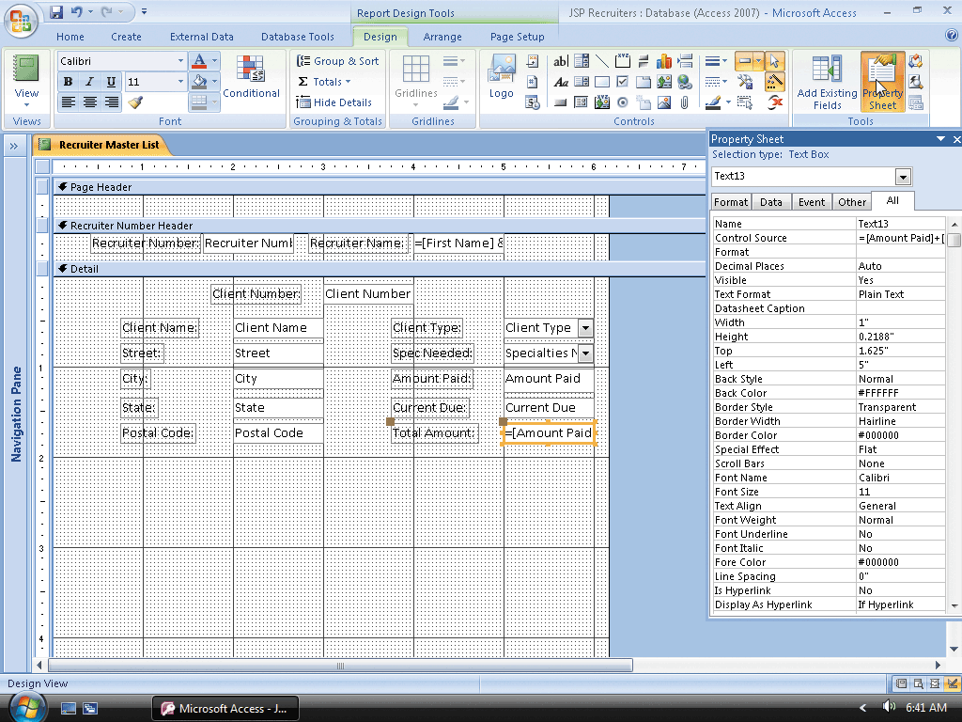
Formatting a Control

Slide 29
Grouping Controls
Click the Client Number control to select it
While holding the SHIFT key down, click all the other controls in the Detail section to select them
Release the SHIFT key
Click Arrange on the Ribbon to display the Arrange tab
Click the Group button on the Arrange tab to group the controls

Slide 30
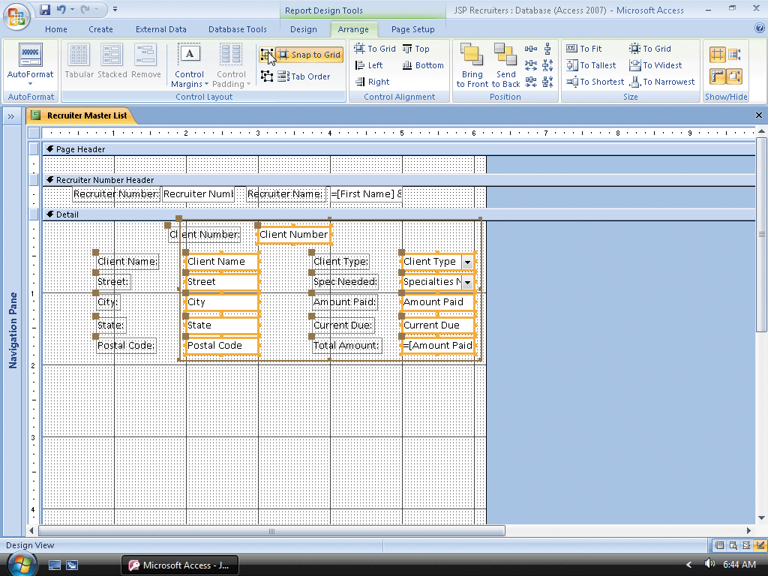
Grouping Controls

Slide 31
Updating Grouped Controls
If necessary, click any one of the grouped controls to select the group
Click Design on the Ribbon to display the Design tab
Click the Bold button on the Design tab to bold all the controls in the group
Drag the right sizing handle of the Specialties Needed field to the approximate position to resize all the controls in the group
Click the Property Sheet button on the Design tab to display the property sheet for the grouped controls

Slide 32
Updating Grouped Controls
With the All tab selected, click the Border Style property box to display an arrow and then click the arrow to display the list of available border styles
Click Solid to change the border styles for all the controls in the group to Solid
Close the property sheet

Slide 33
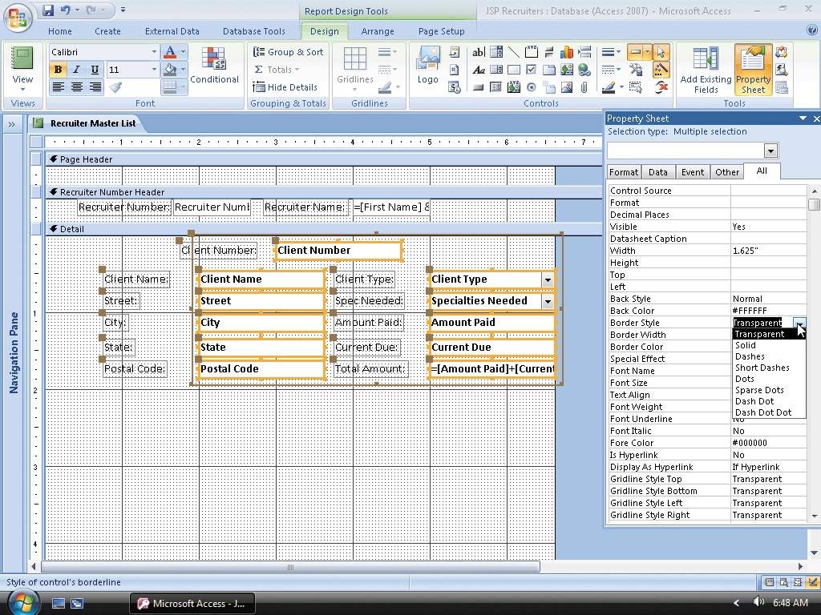
Updating Grouped Controls

Slide 34
Updating Multiple Controls that Are Not Grouped
Click the label for the Client Number control to select it
While holding the SHIFT key down, click the labels for all the other controls in the Detail section to select them
Release the SHIFT key
Click the Italic button to italicize the labels
Click in the vertical ruler to the left of the Recruiter Number Header section to select all the controls in the section

Slide 35
Updating Multiple Controls that Are Not Grouped
Click the Bold button on the Design tab to bold all the selected controls
Click outside the selected controls to deselect them. Click the control containing the expression for the recruiter’s name to select it
Drag the right sizing handle of the selected control to the approximate position

Slide 36
Adding a Sub-report
Click the Use Control Wizards button, click the Sub-form/Sub-report tool, and then move the pointer, which has changed to a plus sign with a sub-report
Click the position to place the sub-report and display the Sub-Report Wizard dialog box. Be sure the ‘Use existing Tables and Queries’ option button is selected
Click the Next button
Click the Tables/Queries box arrow
Scroll down until Query: Seminar Offerings and Seminars is visible, click Query: Seminar Offerings and Seminars, and then click the Add All Fields button to select all the fields in the query

Slide 37
Adding a Sub-report
Click the Next button, type Seminar Offerings by Client as the name of the sub-report, and then click the Finish button to add the sub-report
Click outside the sub-report to deselect the sub-report.
Click the Save button on the Quick Access Toolbar to save your changes
Close the Recruiter Master List report

Slide 38
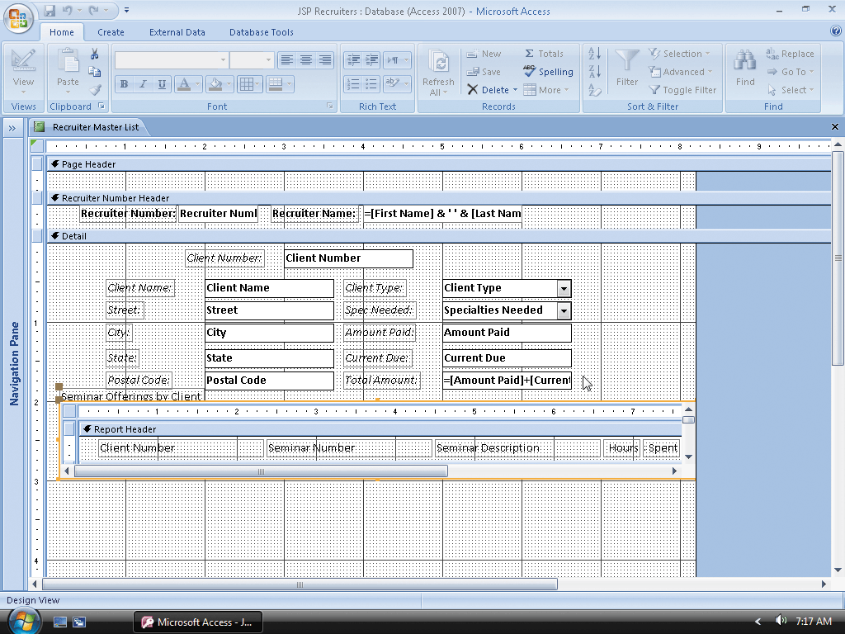
Adding a Sub-report

Slide 39
Opening the Sub-report in Design View
Show the Navigation Pane, scroll down so that the Seminar Offerings by Client report appears, and then right-click the Seminar Offerings by Client report to produce a shortcut menu
Click Design View on the shortcut menu to open the sub-report in Design view
Hide the Navigation Pane
Click the Client Number control in the Detail section to select the control

Slide 40
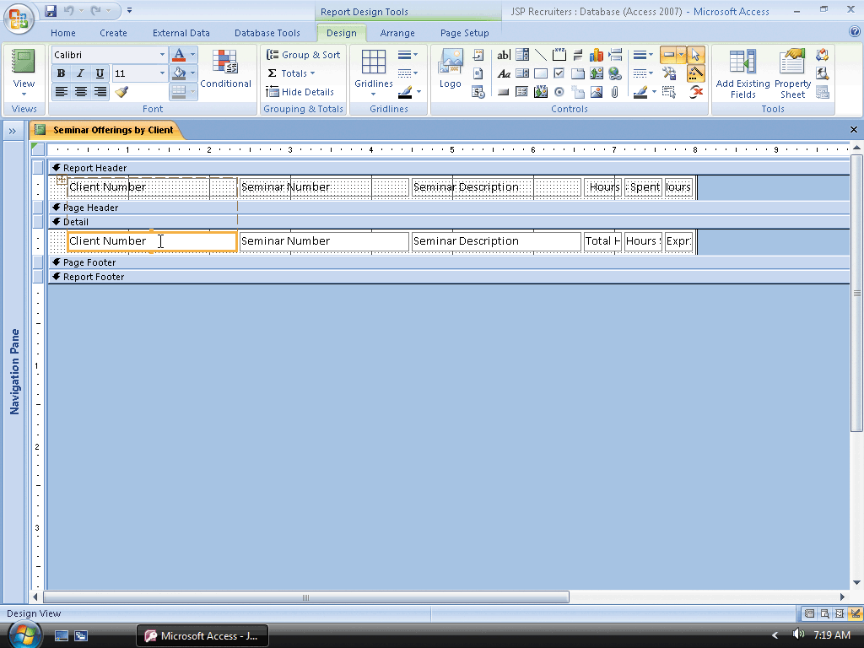
Opening the Sub-report in Design View

Slide 41
Modifying the Controls in the Sub-report
With the Client Number control selected, press the DELETE key to delete the control
Change the labels in the Report Header section to match those shown in Figure 7–38. To extend a heading over two lines, click prior to the second word to produce an insertion point and then press SHIFT+ENTER to move the second word to a second line
Change the sizes of the controls to match those in the figure by selecting the controls and dragging the sizing handles.
Use the alignment buttons on the Design tab to change the alignment to Center or Right as necessary to match the labels in the figure

Slide 42
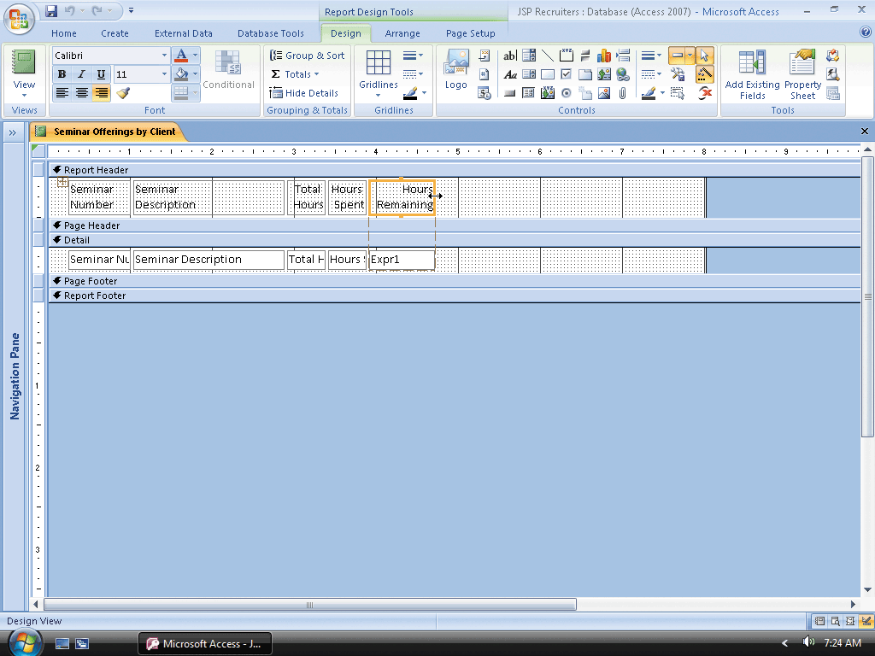
Modifying the Controls in the Sub-report

Slide 43
Changing the Can Grow Property
Click the Seminar Description control to select it
Click the Property Sheet button on the Design tab to display the property sheet
With the All tab selected, scroll down until the Can Grow property appears, click the Can Grow property box arrow to display the list of possible values for the Can Grow property
Click Yes in the list
Close the property sheet

Slide 44
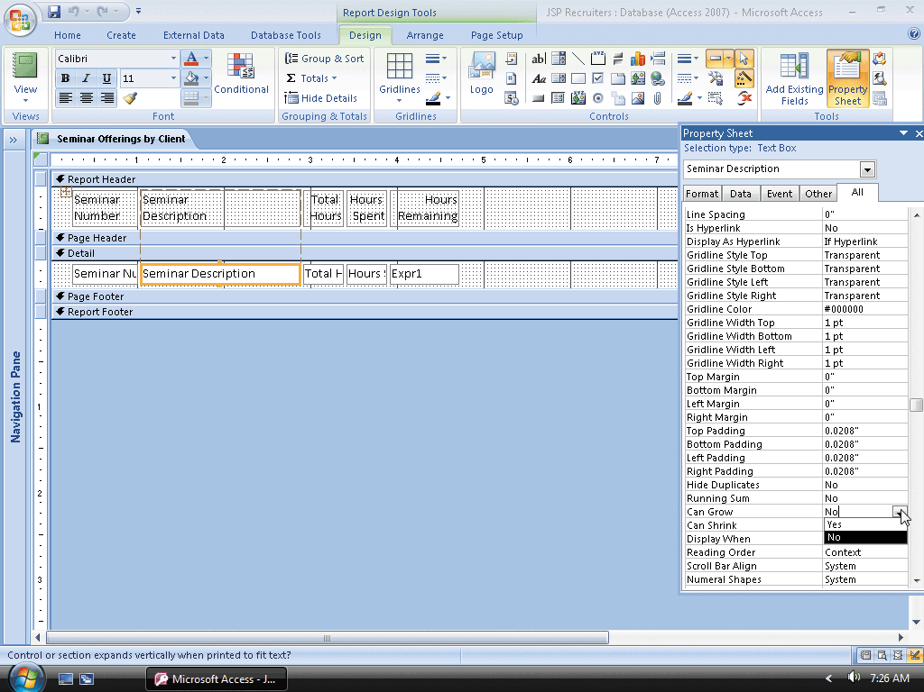
Changing the Can Grow Property

Slide 45
Changing the Appearance of the Controls in the Sub-report
Drag the right boundary of the sub-report to the approximation position
Click the ruler to the left of the controls in the Detail section to select the controls, and then click the Bold button on the Design tab to bold the controls
Click the ruler to the left of the labels in the Report Header section to select the labels, and then click the Italic button on the Design tab to italicize the controls
Click the Save button on the Quick Access Toolbar to save the changes
Close the Seminar Offerings by Client sub-report

Slide 46
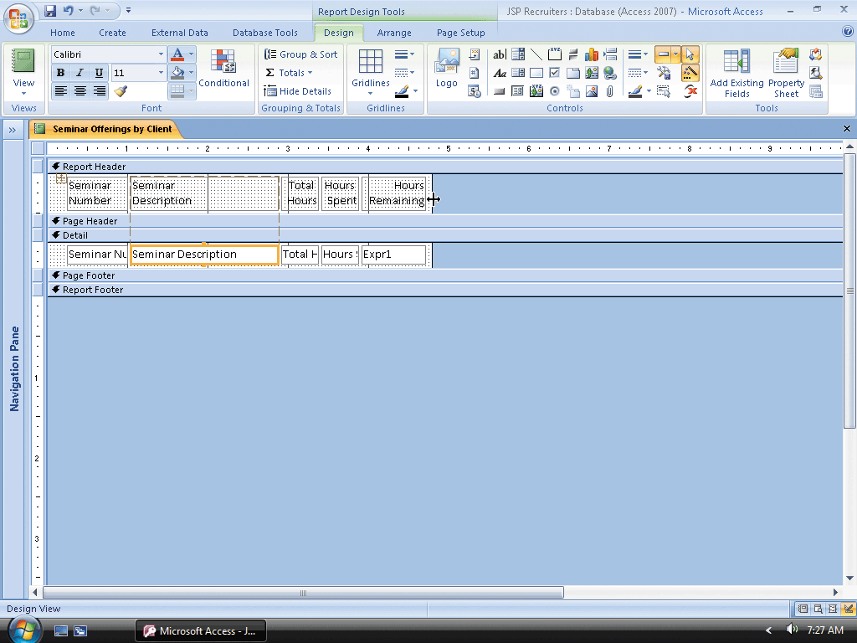
Changing the Appearance of the Controls in the Sub-report

Slide 47
Resizing the Sub-report and the Report
Show the Navigation Pane
Open the Recruiter Master List in Design view
Click the sub-report and then drag the right sizing handle to change the size to the approximate size shown in Figure 7–41, and then drag the sub-report to the approximate position shown in the figure
Drag the right boundary of the report to the approximate position shown in the figure

Slide 48
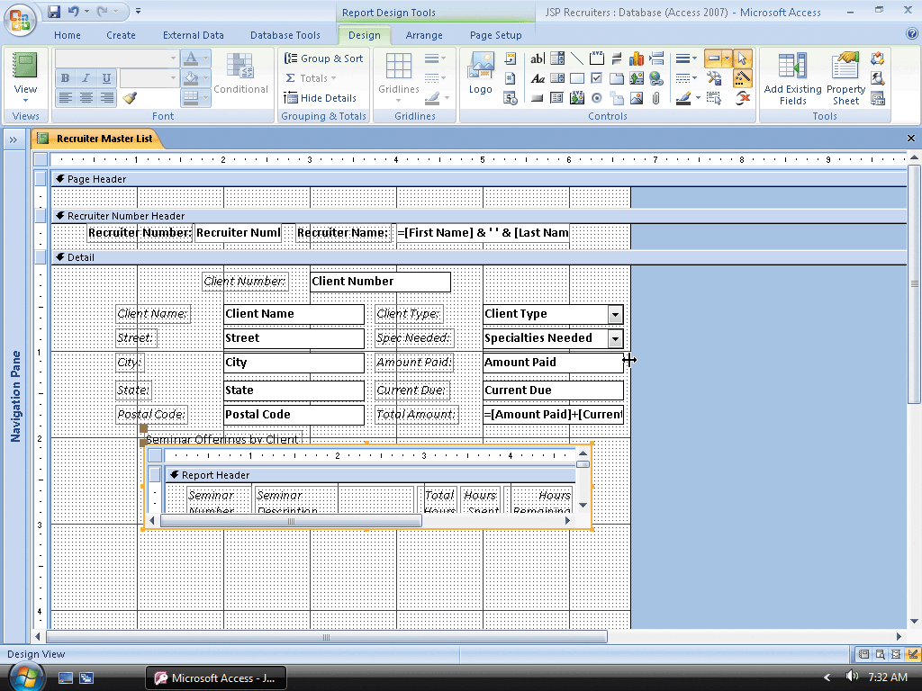
Resizing the Sub-report and the Report

Slide 49
Modifying Section Properties
Click the label for the sub-report (the label that reads Seminar Offerings by Client), and then press the DELETE key to delete the label
Click the Recruiter Number Header bar to select the header and then click the Property Sheet button on the Design tab to display the property sheet
With the All tab selected, click the Repeat Section property box, click the arrow that appears, and then click Yes to cause the contents of the group header to appear at the top of each page
Click the Force New Page property box, click the arrow that appears, and then click Before Section to cause a new group to begin at the top of the next page
Close the property sheet

Slide 50
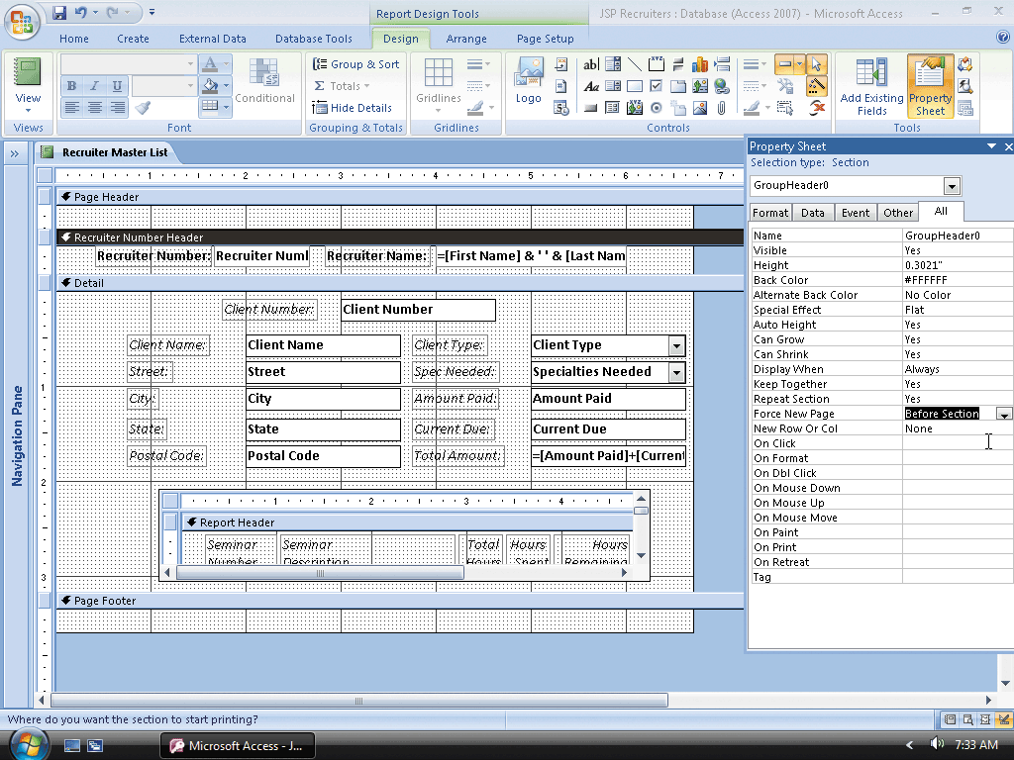
Modifying Section Properties

Slide 51
Adding a Title, Page Number, and Date
Click the Title button on the Design tab to add a title and then drag the title to the middle of the Report Header section
Click the Insert Page Number button on the Design tab to display the Page Numbers dialog box
Be sure Page N and Top of Page [Header] option buttons are selected and then, if necessary, click the Alignment arrow and select Left
Click the OK button to add the page number
Click the Date & Time button on the Design tab to display the Date and Time dialog box

Slide 52
Adding a Title, Page Number, and Date
Click the option button for the third date format and click the Include Time check box to remove the check mark
Click the OK button to add the date to the Report Header
Drag the Date control to the position shown in
Drag the boundary of the report to the position shown in the figure

Slide 53
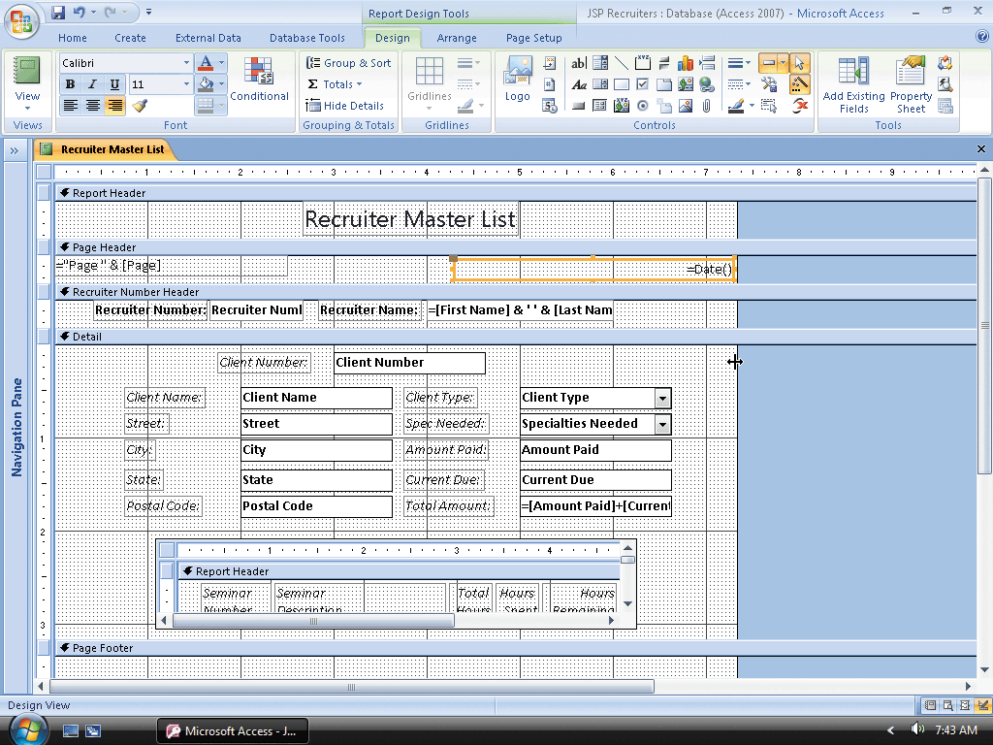
Adding a Title, Page Number, and Date

Slide 54
Saving and Closing the Report
Click the Save button on the Quick Access Toolbar to save the report
Close the report by clicking the Close ‘Recruiter Master List’ button

Slide 55
Printing the Report
Show the Navigation Pane, ensure the Recruiter Master List report is selected, and then click the Office Button to display the Microsoft Office Button menu
Point to Print on the Office Button menu and then click Quick Print on the Print submenu to print the report

Slide 56
Creating a Second Report
Hide the Navigation Pane
Click Create on the Ribbon to display the Create tab and then click the Report Design button on the Ribbon to create a report in Design view
Ensure the selector for the entire report, which is the box in the upper-left corner of the report, is selected and then click the Property Sheet button on the Design tab to display a property sheet
With the All tab selected, click the Record Source property box, click the arrow that appears, and then click the Recruiters and Clients query to select the query as the record source for the report
Close the property sheet by clicking the Property Sheet button on the Design tab

Slide 57
Creating a Second Report
Click the Group & Sort button to display the Group, Sort, and Total pane
Click the ‘Add a group’ button to display the list of available fields for grouping and then click the Recruiter Number field to group by Recruiter Number
Click the ‘Add a sort’ button to display the list of available fields for sorting, and then click the Client Number field to sort by Client Number
Remove the Group, Sort, and Total pane by clicking the Group & Sort button on the Design tab

Slide 58
Adding a Field to the Report
Click the Add Existing Fields button on the Design tab to add a field list
If necessary, click the ‘Show only fields in the current record source’ link at the bottom of the field list to display only those fields in the Recruiters and Clients query
Drag the Recruiter Number field to the approximate position
Click the label for the Recruiter Number control to select it
Click Home on the Ribbon to display the Home tab

Slide 59
Adding a Field to the Report
Click the Cut button on the Home tab to cut the label
Click the Page Header bar to select the page header
Click the Paste button on the Home tab to paste the label in the Page Header section
Click in the label in front of the word, Number, to produce an insertion point
Press SHIFT+ENTER to move the word, Number, to a second line
Erase the colon following the word, Number

Slide 60
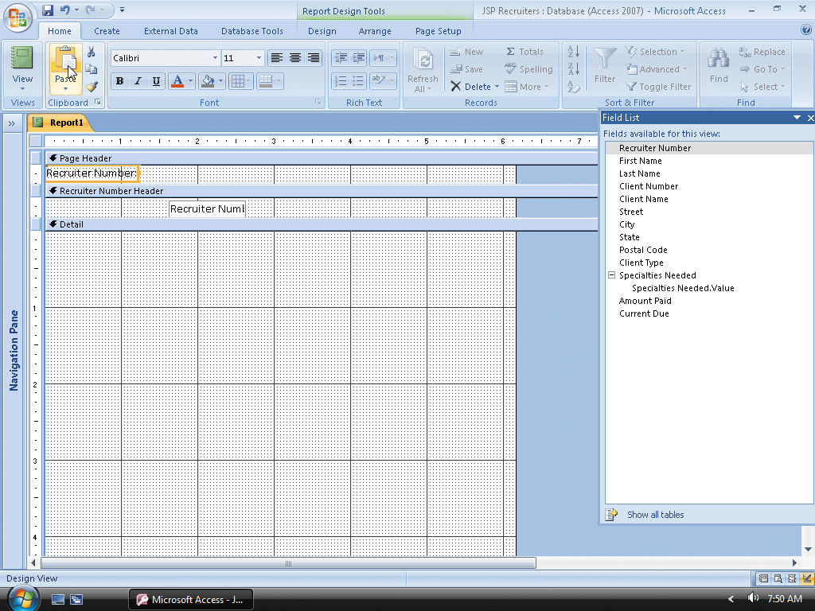
Adding a Field to the Report

Slide 61
Adding the Remaining Fields
Resize and move the Recruiter Number control to the approximate size and position
Resize the Recruiter Number label to the size shown in the figure
Drag the First Name, Last Name, Client Number, Client Name, Amount Paid, and Current Due fields into the Detail section, as shown in the figure
Close the field list
Click the Save button on the Quick Access toolbar, type Discount Report as the report name, and click the OK button to save the report

Slide 62
Adding the Remaining Fields
One at a time, cut each of the labels, paste the label into the Page Header section, resize, reformat, delete the colon, and move the labels to the approximate positions
One at a time, resize and move the First Name and Last Name controls to the approximate positions in the Recruiter Number Header section shown in the figure
One at a time, resize and move the Client Number, Client Name, Amount Paid, and Current Due controls to the approximate positions in the Detail section shown in the figure
Select both the Amount Paid and Current Due labels and click Home on the Ribbon to display the Home tab
Click the Align Text Right button on the Design tab to align the headings to the right, as shown in the figure

Slide 63
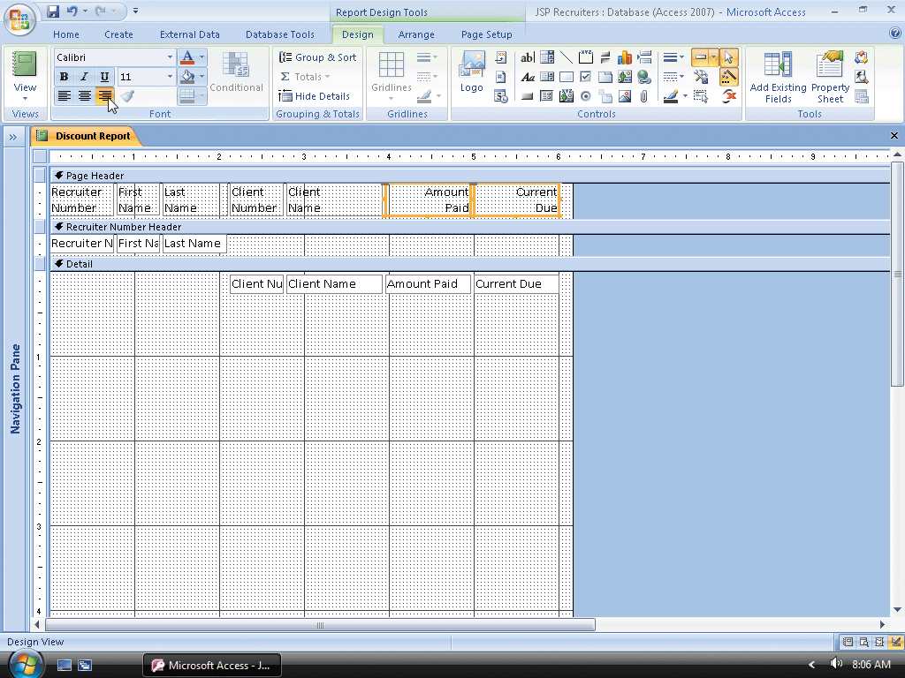
Adding the Remaining Fields

Slide 64
Resizing the Detail Section
Scroll down so that the lower boundary of the Detail section appears and then drag the lower boundary of the section to a position just slightly below the controls in the section

Slide 65
Adding Totals and Subtotals
Click the Group & Sort button on the Design tab to display the Group, Sort, and Total pane
Click Group on Recruiter Number and then click the More Options arrow to display additional options
Click the ‘without a footer section’ arrow to display the available options Click ‘with a footer section’ to add a footer
Close the Group, Sort, and Total pane by clicking the Group & Sort button on the Design tab.
Click the Text Box tool on the Design tab, and then point to the position

Slide 66
Adding Totals and Subtotals
Click the position shown in Figure 7–56 on the previous page to place a text box
Type =Sum([Current Due]) in the control, and then press the ENTER key
Click the label to select it
Click the label a second time to produce an insertion point
Use the DELETE or BACKSPACE key to delete the Text8 (your number might be different). Do not delete the colon
Type Subtotals as the label

Slide 67
Adding Totals and Subtotals
Click outside the label to deselect it
Resize and align the Current Due controls in the Detail section and the Recruiter Number footer section
Click the Text Box tool on the Design tab, and then click in the Recruiter Number Footer just to the left of the control for the sum of Current Due to place another text box
Click the text box to produce an insertion point, type =Sum ([Amount Paid]) in the control, and then press the ENTER key to enter the expression
Click the label to select it, and then press the DELETE key to delete the label

Slide 68
Adding Totals and Subtotals
Click the control for the sum of Amount Paid to select it and then hold the SHIFT key down and click the control for the sum of Current Due to select both controls
Click the Property Sheet button on the Design tab to display the property sheet
Change the format to Currency and the number of decimal places to 2
Close the property sheet
Click Arrange on the Ribbon to display the Arrange tab

Slide 69
Adding Totals and Subtotals
Click the Report Header/Footer button to display the Report Footer section
Click the ruler in the Recruiter Number Footer to the left of the controls in the section to select the controls
Click Home on the Ribbon to display the Home tab
Click the Copy button on the Home tab to copy the selected controls to the clipboard

Slide 70
Adding Totals and Subtotals
Click the Report Footer bar to select the footer and then click the Paste button on the Home tab to paste a copy of the controls into the report footer
Move the controls to the positions
Click the label in the Report Footer section to select the label and then click a second time to produce an insertion point
Use the BACKSPACE or DELETE key to erase the current contents other than the colon and then type Grand totals in front of the colon to change the label

Slide 71
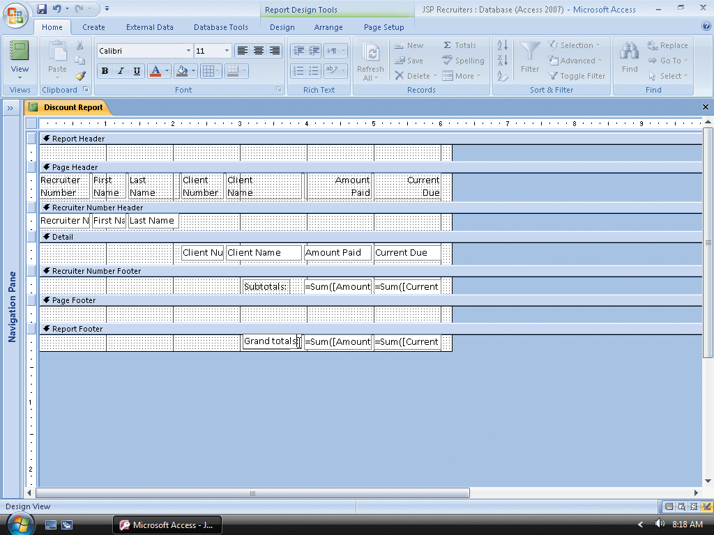
Adding Totals and Subtotals

Slide 72
Viewing the Report
Click the View button arrow on the Home tab to display the View button menu
Click Print Preview on the View button menu to view the report in Print Preview

Slide 73
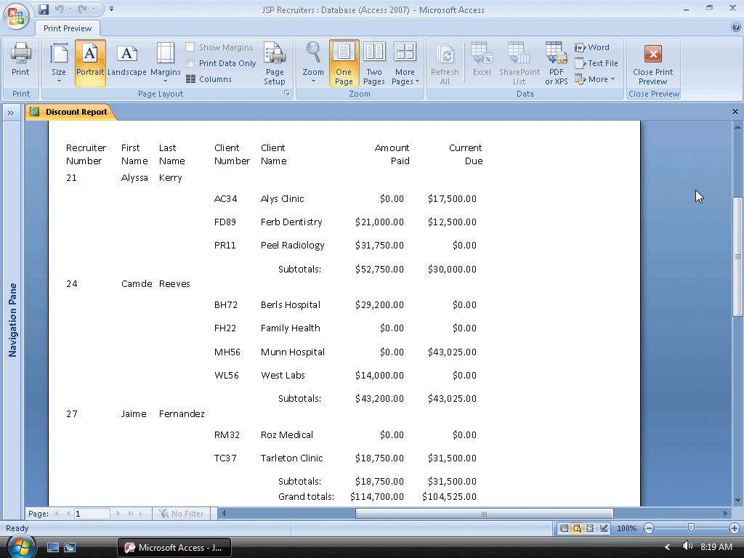
Viewing the Report

Slide 74
Assigning a Conditional Value
Click the Close Print Preview button arrow on the Print Preview tab to return to Design view
If necessary, click Design on the Ribbon to display the Design tab
Click the Text Box tool on the Design tab and point to the approximate position
Click the position to place a text box
Click the attached label to select it and then press the DELETE key to delete the attached label

Slide 75
Assigning a Conditional Value
Click the text box to select it and then click the Property Sheet button on the Design tab to display a property sheet
Click the Control Source property to select it
Click the Build button to display the Expression Builder dialog box
Double-click Functions in the first column to display the function subfolders
Click Built-In Functions in the first column to display the various function categories in the second column
Scroll down in the second column so that Program Flow appears, and then click Program Flow to display the available program flow functions in the third column

Slide 76
Assigning a Conditional Value
Click IIF in the third column to select the IIF function and then click the Paste button
Click the <expr> argument to select it and type [Amount Paid]>20000 as the expression
Click the <truepart> argument and type .04*[Current Due] as the true part.
Click the <falsepart> argument and type .02*[Current Due] as the false part
Click the OK button in the Expression Builder dialog box to specify the expression as the control source for the text box

Slide 77
Assigning a Conditional Value
Change the format to Currency
Change the number of decimal places to 2
Close the property sheet by clicking the Property Sheet button
Click the Label (Form Control) tool on the Design tab and point to the approximate position
Press and hold the left mouse button, drag the pointer to the approximate position for the lower-right corner of the label, and then release the left mouse button to place the label
Type Discount to enter the name of the label

Slide 78
Assigning a Conditional Value
Click outside the label to deselect the label and then click the label to select it once more
Click the Align Text Right button on the Design tab to right-align the text within the label
Move or resize the label as necessary so that it aligns with the new text box and with the other controls in the Page Header section
Using the techniques on Pages AC 490 and AC 491, add a title, page number, and date at the positions
Resize the Report Header section to the approximate size shown in the figure by dragging its lower edge
If necessary, drag the right boundary of the report to the position shown in the figure
Click Page Setup on the Ribbon to display the Page Setup tab as shown in the figure

Slide 79
Changing the Report Margins
Click the Margins button on the Page Setup tab
If necessary, click Narrow to specify the Narrow margin option

Slide 80
Saving and Closing the Report
Click the Save button on the Quick Access Toolbar to save the report
Close the report by clicking the Close ‘Discount Report’ button

Slide 81
Printing the Report
Show the Navigation Pane, ensure that Discount Report is selected, and then click the Office Button to display the Microsoft Office Button menu
Point to Print on the Office Button menu and then click Quick Print on the Print submenu to print the report

Slide 82
Creating Labels
Show the Navigation Pane and select the Client table
Click Create on the Ribbon to display the Create tab
Click the Labels button on the Ribbon to display the Label Wizard dialog box
Ensure that English is selected as the Unit of Measure and that Avery is selected in the “Filter by manufacturer” box
Click C2163 in the Product number list

Slide 83
Creating Labels
Click the Next button
Click the Next button to accept the default font and color settings
Click the Client Name field and then click the Add Field button
Click the second line in the label, and then add the Street field
Click the third line of the label
Add the City field, type , (a comma), press the SPACEBAR, add the State field, press the SPACEBAR, and then add the Postal Code field

Slide 84
Creating Labels
Because the label now is complete, click the Next button
Select the Postal Code field as the field to sort by, and then click the Add Field button
Click the Next button
Ensure the name for the report (that is, the labels) is Labels Client
Click the Finish button to complete the labels
Close the Labels Client report

Slide 85
Printing Labels
Show the Navigation Pane and ensure the Labels Client report is selected and then click the Office Button to display the Microsoft Office menu
Point to Print on the Office Button menu and then click Quick Print on the Print submenu to print the report

Slide 86
Quitting Access
Click the Close button on the right side of the Access title bar to quit Access

Slide 87
Quitting Access
Click the Close button on the right side of the Access title bar to quit Access

Slide 88
Summary
Change a caption
Create queries for reports
Create reports in Design view
Add fields and text boxes to a report
Format controls
Group and ungroup controls

Slide 89
Summary
Update multiple controls
Add and modify a sub-report
Modify section properties
Add a title, page number, and date
Add totals and subtotals
Create and print mailing labels

Slide 90
Access 2007 Chapter 7 Complete
Advanced Report Techniques

