Slide 1
Access Integration Feature
Sharing Data Among
Applications

Slide 2
Objectives
Import from or link to an Excel worksheet
Import from or link to an Access database
Import from or link to a text file
Export data to Excel, Word, and text files
Publish a report
Export and import XML data

Slide 3
Plan Ahead
Identify sources of external data for the database
Determine whether the date you have identified is in an appropriate format
Determine whether changes made to the data in the original data source should be reflected in the Access table
If the source of data is an Access database, determine whether, in addition to the tables, there are other objects to be imported
For data in your database that you want to make available to others, determine whether exporting the data is appropriate
If data is to be exported, determine the destination application

Slide 4
Starting Access
Click the Start button on the Windows taskbar to display the Start menu
Click All Programs at the bottom of the left pane on the Start menu to display the All Programs list and then click Microsoft Office in the All Programs list to display the Microsoft Office list
Click Microsoft Office Access 2007 on the Microsoft Office submenu to start Access and display the Getting Started with Microsoft Office Access window
If the Access window is not maximized, click the Maximize button on its title bar to maximize the window

Slide 5
Creating a New Database
With a USB flash drive connected to one of the computer’s USB ports, click Blank Database in the Getting Started with Microsoft Office Access screen to create a new blank database
Type Camashaly in the File Name text box and then click the ‘Browse for a location to put your database’ button to display the File New Database dialog box
Click Computer in the Favorite Links section to display a list of available drives and folders and then double-click UDISK 2.0 (E:) (your letter may be different) in the Computer list to select the USB flash drive as the new save location
Click the OK button to select the USB flash drive as the location for the database and to return to the Getting Started with Microsoft Office Access screen
Click the Create button to create the database on the USB flash drive with the file name, Camashaly

Slide 6
Importing an Excel Worksheet
Click External Data on the Ribbon to display the External Data tab
Click the Excel button in the Import group on the External Data tab to display the Get External Data – Excel Spreadsheet dialog box
Click the Browse button in the Get External Data – Excel Spreadsheet dialog box
If necessary, click the Look in box arrow and then click UDISK 2.0 (E:) to select the USB flash drive in the Look in list as the new open location. (Your drive letter might be different.)
Click the Computer Items workbook, and then click the Open button to select the workbook

Slide 7
Importing an Excel Worksheet
With the option button to import the data to a new table selected, click the OK button to display the Import Spreadsheet Wizard dialog box
If necessary, click First Row Contains Column Headings to select it
Click the Next button
Because the Field Options need not be specified, click the Next button

Slide 8
Importing an Excel Worksheet
Click the ‘Choose my own primary key.’ option button
Because the Item Id field, which is the correct field, is already selected as the primary key, click the Next button
Be sure Item appears in the Import to Table text box
Click the Finish button to import the data

Slide 9
Importing an Excel Worksheet
Click the Save import steps check box to display the Save import steps options
If necessary, type Import-Computer Items in the Save as text box
Type Import data from Computer Items workbook into Item table in the Description text box
Click the Save Import button to save the import steps

Slide 10
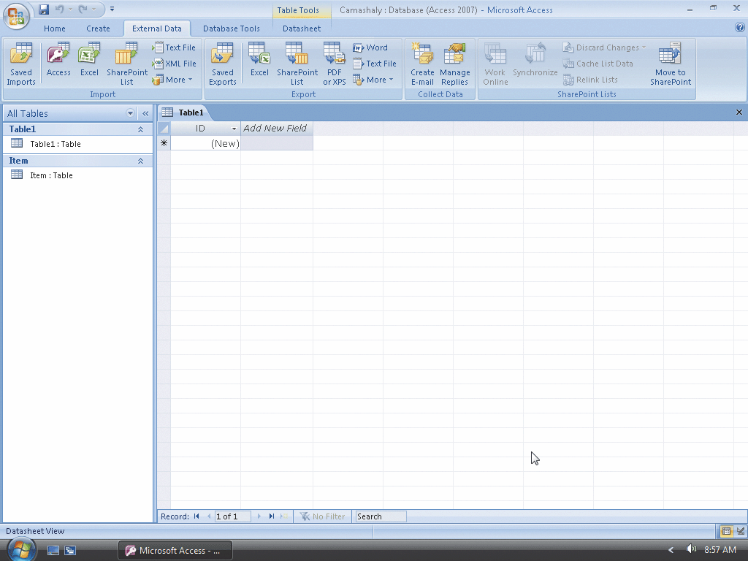
Importing an Excel Worksheet

Slide 11
Closing a Database
Click the Office Button to display the Office Button menu
Click Close Database on the Office Button menu

Slide 12
Opening a Database
With your USB flash drive connected to one of the computer’s USB ports, click the More button to display the Open dialog box
If the Folders list is displayed below the Folders button, click the Folders button to remove the Folders list
If necessary, click Computer in the Favorite Links section and then double-click UDISK 2.0 (E:) to select the USB fl ash drive as the new open location. (Your drive letter might be different.)
Click JSP Recruiters to select the file name
Click the Open button to open the database
If a Security Warning appears, click the Options button to display the Microsoft Office Security Options dialog box
Click the ‘Enable this content’ option button and then click the OK button to enable the content

Slide 13
Exporting Data to Excel
Click the Recruiter-Client Query in the Navigation pane to select it
Click External Data on the Ribbon to display the External Data tab
Click the Excel button in the Export group on the External Data tab to display the Export – Excel Spreadsheet dialog box
Click the Browse button and select your USB flash drive as the file location
Be sure the file name is Recruiter-Client Query and then click the Save button

Slide 14
Exporting Data to Excel
Click the OK button to export the data
Click the Save export steps check box to display the Save export steps options
If necessary, type Export-Recruiter-Client Query in the Save as text box
Type Export the Recruiter-Client Query without formatting in the Description text box
Click the Save Export button to save the export steps

Slide 15
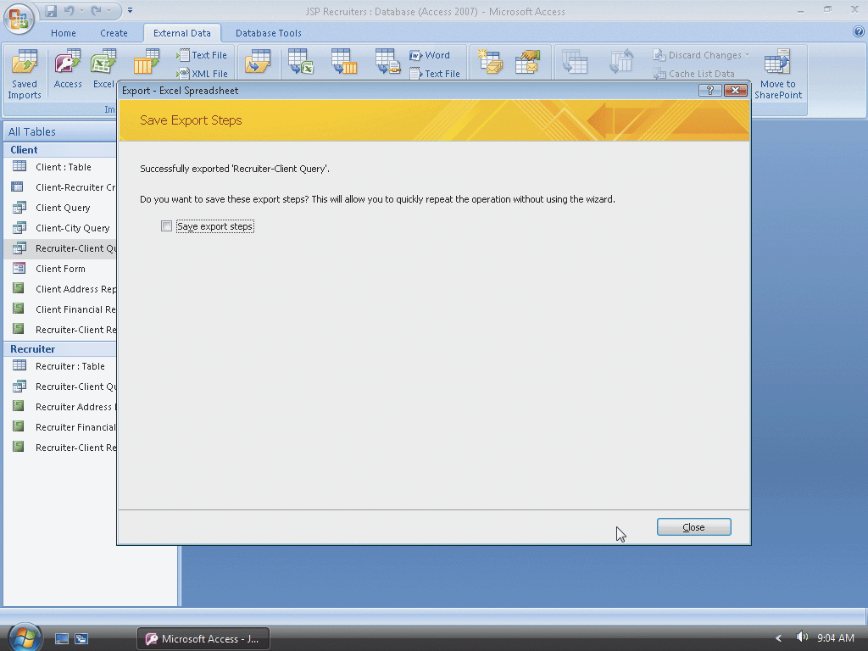
Exporting Data to Excel

Slide 16
Exporting Data to Word
With the Recruiter-Client Query selected in the Navigation pane and the External Data tab appearing on the screen, click the Word button in the Export group on the External Data tab to display the Export - RTF file dialog box
Select your USB drive as the file location and make sure that Recruiter-Client Query is the file name
If necessary, click the Save button and then click the OK button to export the data
Because you will not save the export steps, click the Close button to close the Export – RTF File dialog box

Slide 17
Publishing a Report
Click the Recruiter Financial Report in the Navigation Pane to select it
Click the ‘PDF or XPS’ button in the Export group on the External Data tab (see Figure 14 on page AC 221) to display the Publish as PDF or XPS dialog box
Select your USB drive as the file location. Make sure that Recruiter Financial Report is the file name and that XPS Document is the file type. If necessary, remove the check mark in the ‘Open file after publishing’ check box

Slide 18
Publishing a Report
Click the ‘Standard (publishing online and printing)’ option button to create a file that is appropriate for both publishing online and printing
Click the Publish button to publish the report as an XPS file
Because you will not save the export steps, click the Close button to close the Export – XPS dialog box

Slide 19
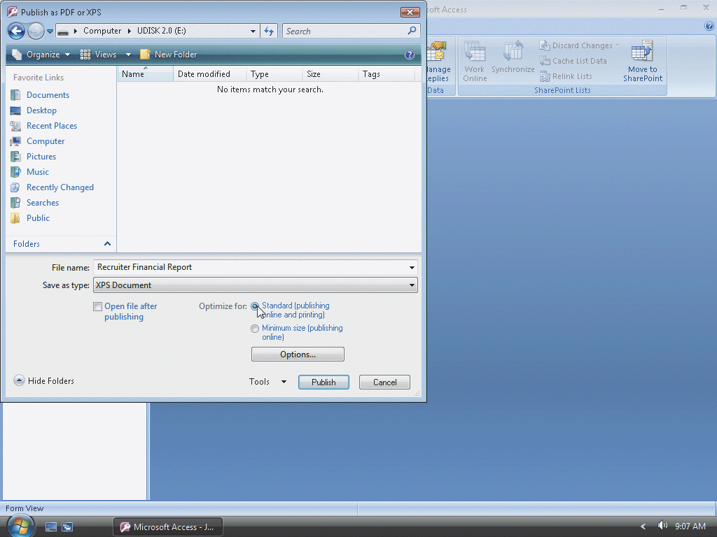
Publishing a Report

Slide 20
Exporting XML Data
Click the Client table in the Navigation pane to select it
Click the More button in the Export group on the External Data tab to display the More button menu with additional export options
Click XML File on the More button menu to display the Export - XML File dialog box
Select your USB drive as the file location and make sure that Client is the file name
Click the OK button to display the Export XML dialog box

Slide 21
Exporting XML Data
Click the More Options button to specify additional options
Click the expand indicator (the plus sign) to the left of [Lookup Data], and then click the Recruiter check box to select the Recruiter table
Click the OK button to export the data
Because you will not save the export steps, click the Close button to close the Export - XML File dialog box
Click the Close Database command on the Office Button menu

Slide 22
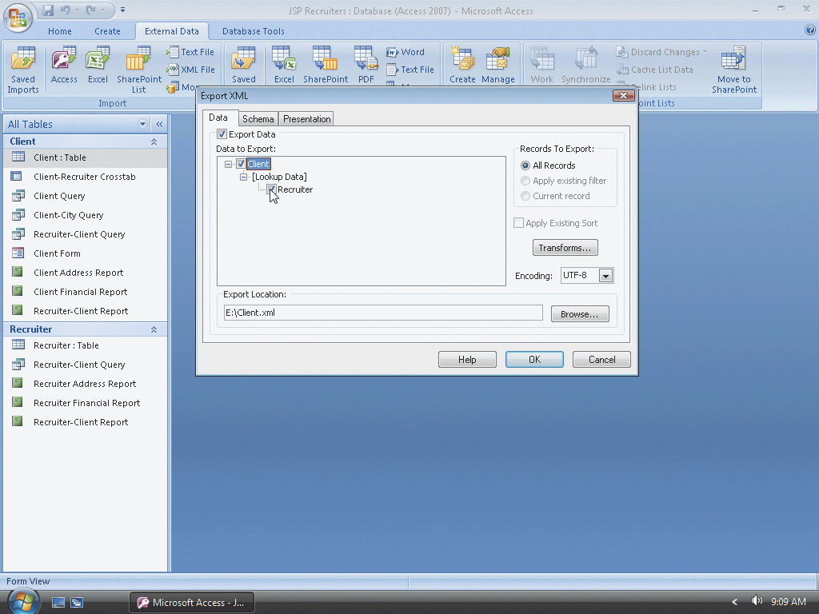
Exporting XML Data

Slide 23
Creating a New Database
With a USB flash drive connected to one of the computer’s USB ports, click Blank Database in the Getting Started with Microsoft Office Access screen to create a new blank database
Type JSP Consulting in the File Name text box and then click the ‘Browse for a location to put your database’ button to display the File New Database dialog box
Click Computer in the Favorite Links section to display a list of available drives and folders and then click UDISK 2.0 (E:) (your letter may be different) in the Computer list to select the USB flash drive as the new save location
Click the OK button to select the USB fl ash drive as the location for the database and to return to the Getting Started with Microsoft Office Access screen
Click the Create button to create the database on the USB fl ash drive with the file name, JSP Consulting

Slide 24
Importing XML Data
With the JSP Consulting database open, click External Data on the Ribbon to display the External Data tab
Click the XML File button in the Import group on the External Data tab to display the Get External Data - XML File dialog box
Click the Browse button in the Get External Data - XML File dialog box to display the File Open dialog box
Click Computer and then double-click UDISK 2.0 (E:)
Click the Client file to select it

Slide 25
Importing XML Data
Click the Open button to return to the Get External Data - XML File dialog box
Click the OK button to display the Import XML dialog box
Be sure the Structure and Data option button is selected and then click the OK button to import the data
Because you will not save the import steps, click the Close button to close the Get External Data - XML File dialog box

Slide 26
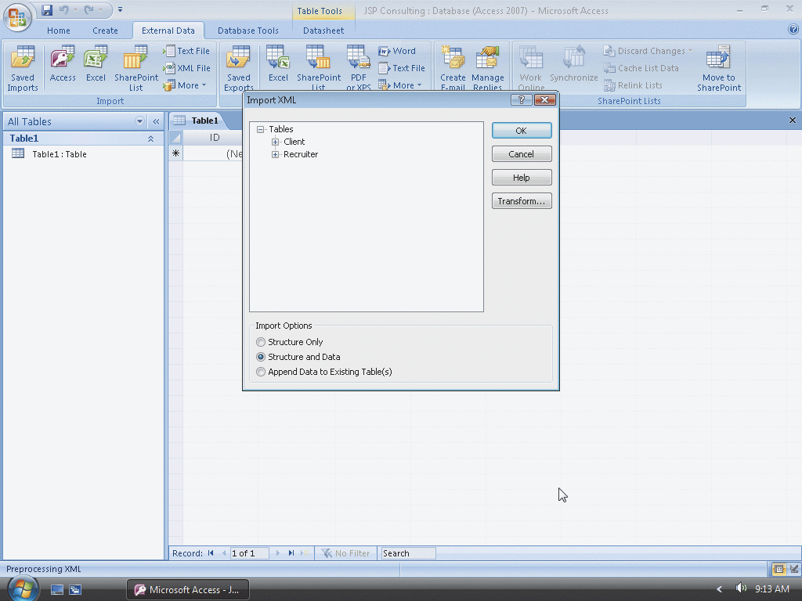
Importing XML Data

Slide 27
Quitting Access
Click the Close button on the right side of the Access title bar to quit Access

Slide 28
Summary
Import from or link to an Excel worksheet
Import from or link to an Access database
Import from or link to a text file
Export data to Excel, Word, and text files
Publish a report
Export and import XML data

Slide 29
Access Integration Feature Complete

